Slide 1
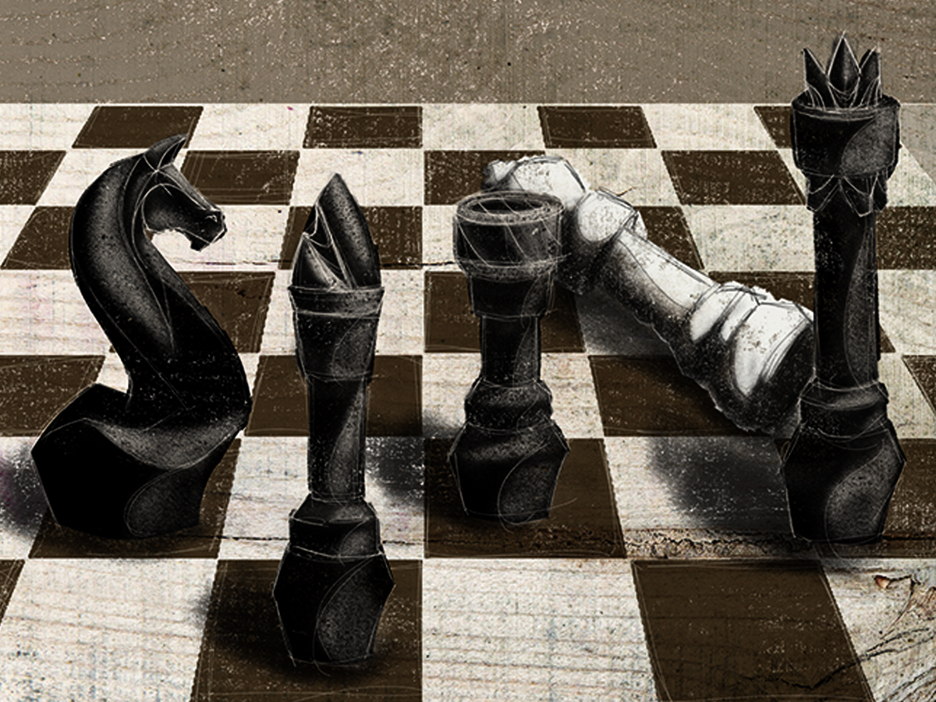
ESV

Slide 2

As it is written: “None is righteous, no, not one; no one understands; no one seeks for God. All have turned aside; together they have become worthless; no one does good, not even one.”
Romans 3:10-12
ESV

Slide 3
SIN IS SIMPLY BAD CHOICES OR MISTAKES THAT I MAKE.
ESV

Slide 4
ALL OF MANKIND IS INFECTED WITH SIN. IT AFFECTS EVERYTHING WE ENCOUNTER. IT IMPACTS ALL OF OUR INTERACTIONS AS WELL AS OUR THOUGHTS. WE CANNOT GET AWAY FROM IT.
ESV

Slide 5
TEMPLATE
•
•
•
ESV

