Slide 1
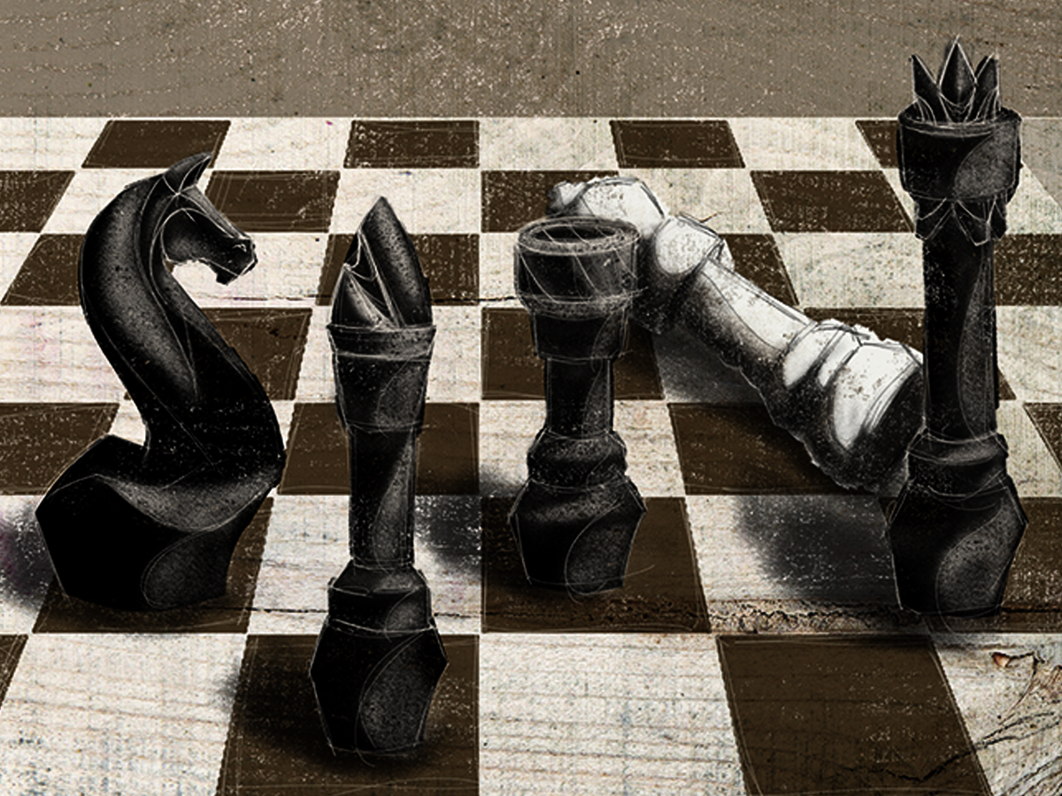
NIV

Slide 2

As it is written: “There is no one righteous, not even one; there is no one who understands, no one who seeks God. All have turned away, they have together become worthless; there is no one who does good, not even one.”
Romans 3:10-12
NIV

Slide 3
SIN IS SIMPLY BAD CHOICES OR MISTAKES THAT I MAKE.
NIV

Slide 4
ALL OF MANKIND IS INFECTED WITH SIN. IT AFFECTS EVERYTHING WE ENCOUNTER. IT IMPACTS ALL OF OUR INTERACTIONS AS WELL AS OUR THOUGHTS. WE CANNOT GET AWAY FROM IT.
NIV

Slide 5
TEMPLATE
•
•
•
NIV

