Slide 1
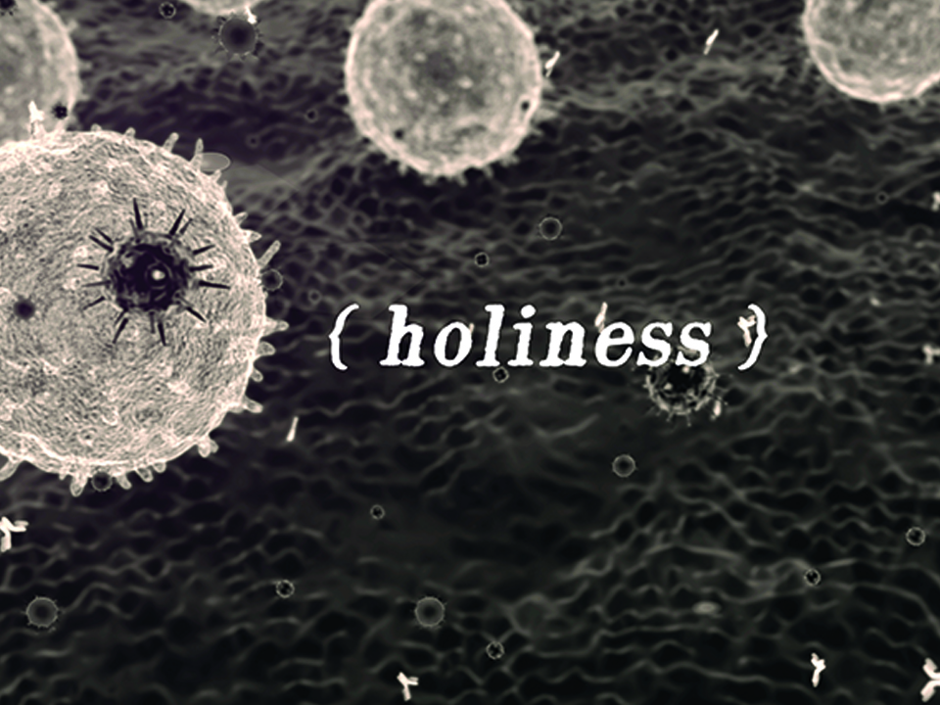
KJV

Slide 2

But as He which hath called you is holy, so be ye holy in all manner of conversation; because it is written,
“Be ye holy; for I am holy.”
1 Peter 1:15-16
KJV

Slide 3
AN OUTWARD SET OF ACTIONS MAKES US GOOD.
KJV

Slide 4
HOLINESS IS A STATE OF BEING THAT IS ESTABLISHED AND GOVERNED BY THE FINISHED WORK OF CHRIST TO BRING MANKIND BACK INTO UNITY WITH HIMSELF.
KJV

Slide 5
TEMPLATE
•
•
•
KJV

