Slide 1
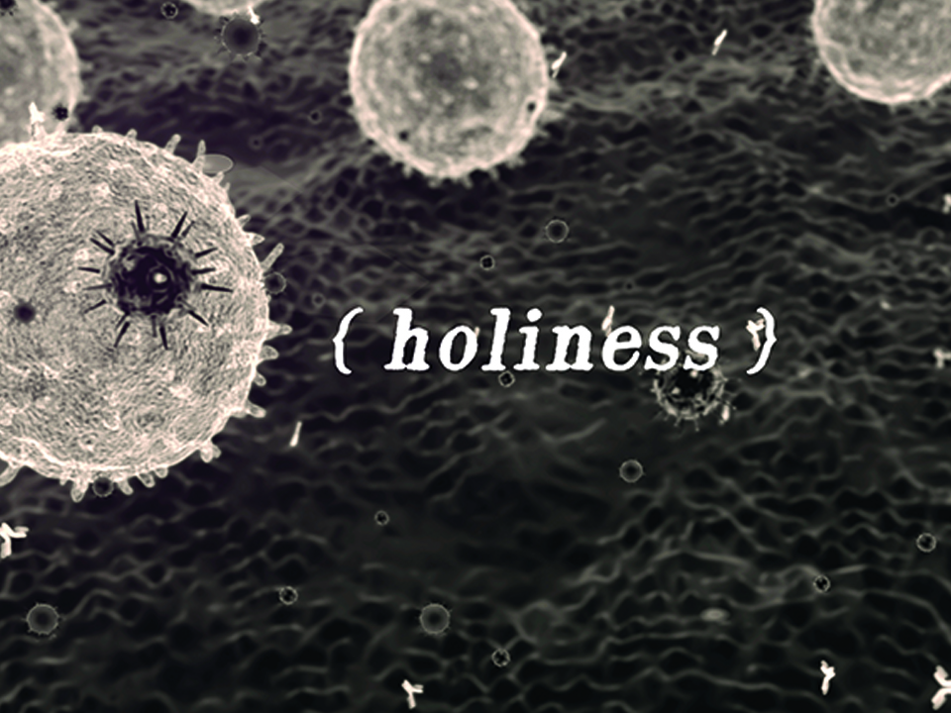
NIV

Slide 2
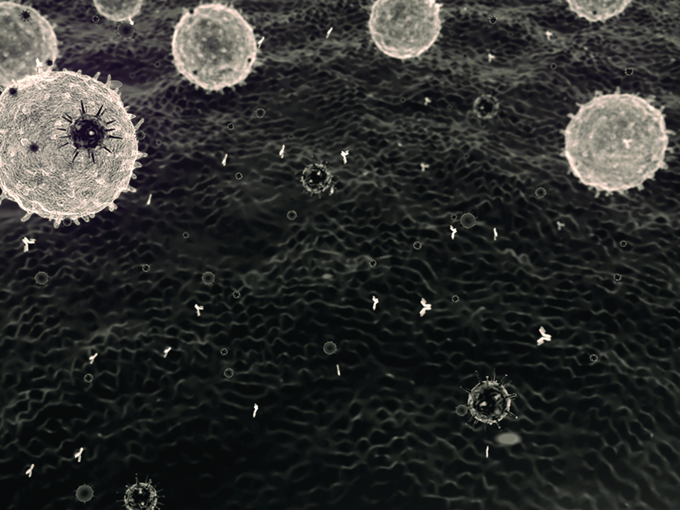
But just as He who called you is holy, so be holy in all you do; for it is written:
“Be holy, because I am holy.”
1 Peter 1:15-16
NIV

Slide 3
AN OUTWARD SET OF ACTIONS MAKES US GOOD.
NIV

Slide 4
HOLINESS IS A STATE OF BEING THAT IS ESTABLISHED AND GOVERNED BY THE FINISHED WORK OF CHRIST TO BRING MANKIND BACK INTO UNITY WITH HIMSELF.
NIV

Slide 5
TEMPLATE
•
•
•
NIV

