Slide 1
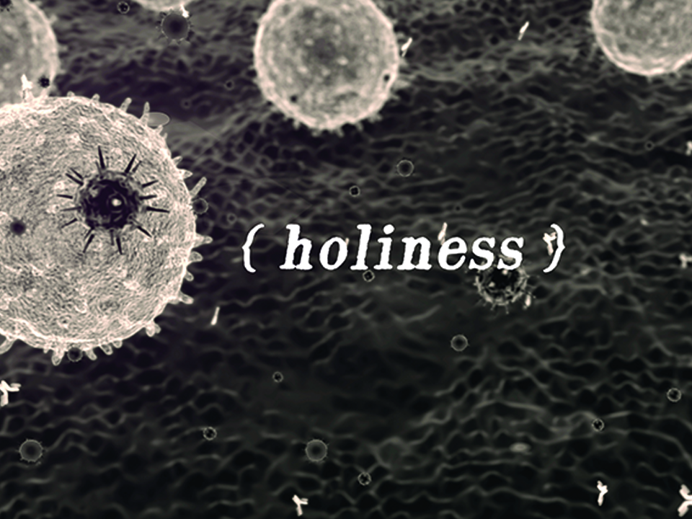
NKJV

Slide 2
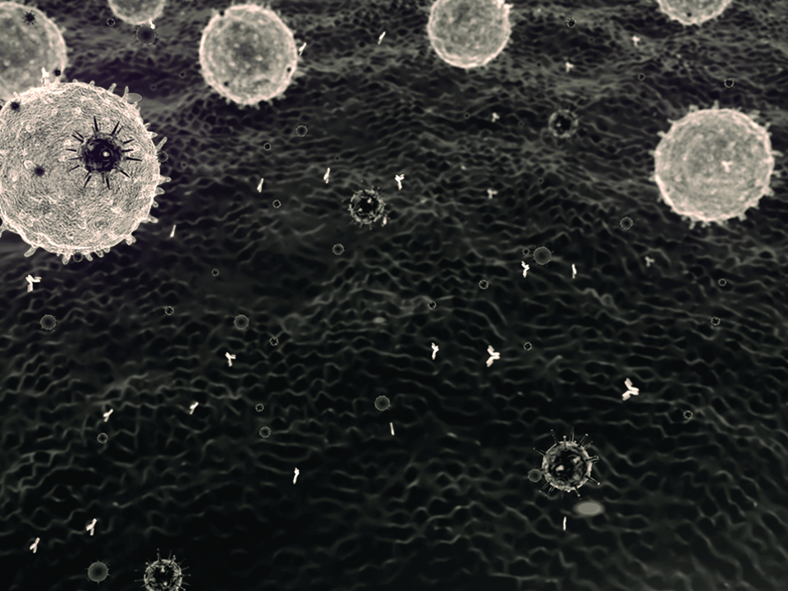
But as He who called you is holy, you also be holy in all your conduct, because it is written, “Be holy, for I am holy.”
1 Peter 1:15-16
NKJV

Slide 3
AN OUTWARD SET OF ACTIONS MAKES US GOOD.
NKJV

Slide 4
HOLINESS IS A STATE OF BEING THAT IS ESTABLISHED AND GOVERNED BY THE FINISHED WORK OF CHRIST TO BRING MANKIND BACK INTO UNITY WITH HIMSELF.
NKJV

Slide 5
TEMPLATE
•
•
•
NKJV

