Slide 1
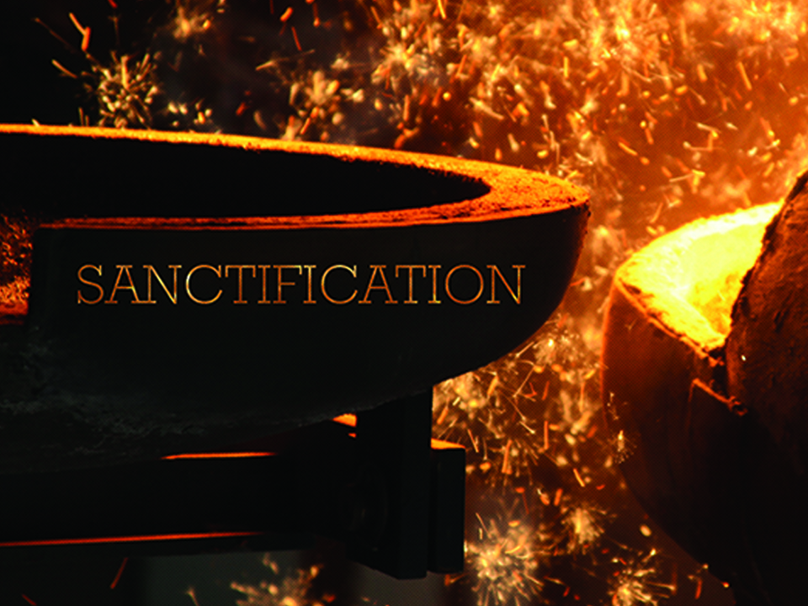
KJV

Slide 2

Wherefore, my beloved, as ye have always obeyed, not as in my presence only, but now much more in my absence, work out your own salvation with fear and trembling. For it is God which worketh in you both to will and to do of His good pleasure.
Philippians 2:12-13
KJV

Slide 3
MY EFFORT WILL DIRECTLY CONTROL THE OUTCOMES OF MY TRANSFORMATION.
KJV

Slide 4
SANCTIFICATION IS NOT A WORK OF YOUR OWN, BUT RATHER A PROCESS OF GOD WORKING WITH YOU BY THE POWER OF THE HOLY SPIRIT TO MAKE YOU MORE LIKE JESUS.
KJV

Slide 5
TEMPLATE
•
•
•
KJV

