Slide 1
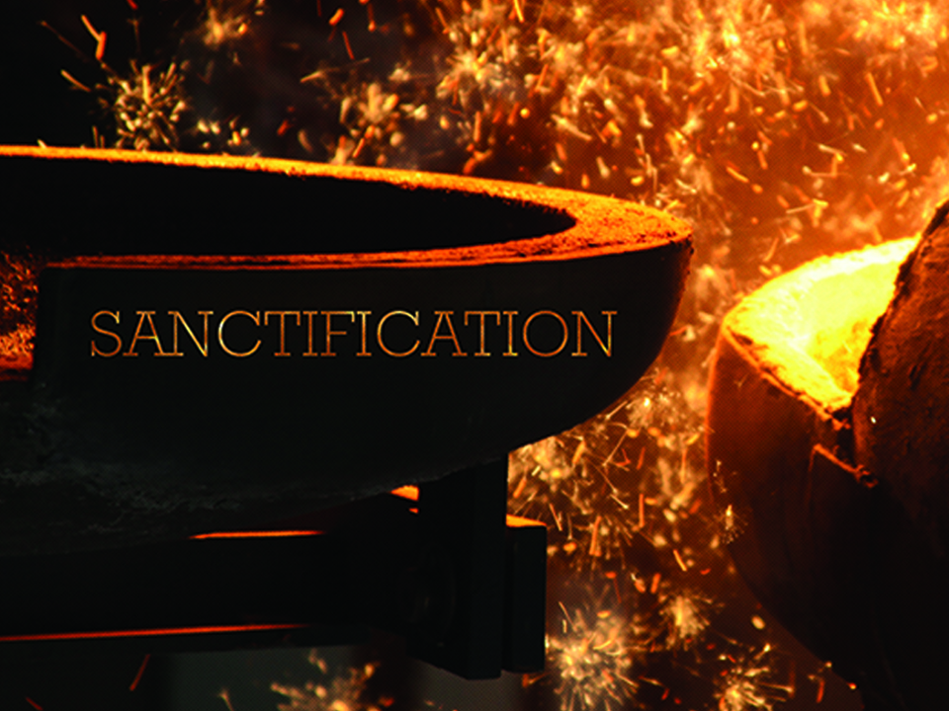
NKJV

Slide 2

Therefore, my beloved, as you have always obeyed, not as in my presence only, but now much more in my absence, work out your own salvation with fear and trembling; for it is God who works in you both to will and to do for His good pleasure.
Philippians 2: 12-13
NKJV

Slide 3
MY EFFORT WILL DIRECTLY CONTROL THE OUTCOMES OF MY TRANSFORMATION.
NKJV

Slide 4
SANCTIFICATION IS NOT A WORK OF YOUR OWN, BUT RATHER A PROCESS OF GOD WORKING WITH YOU BY THE POWER OF THE HOLY SPIRIT TO MAKE YOU MORE LIKE JESUS.
NKJV

Slide 5
TEMPLATE
•
•
•
NKJV

