Slide 1
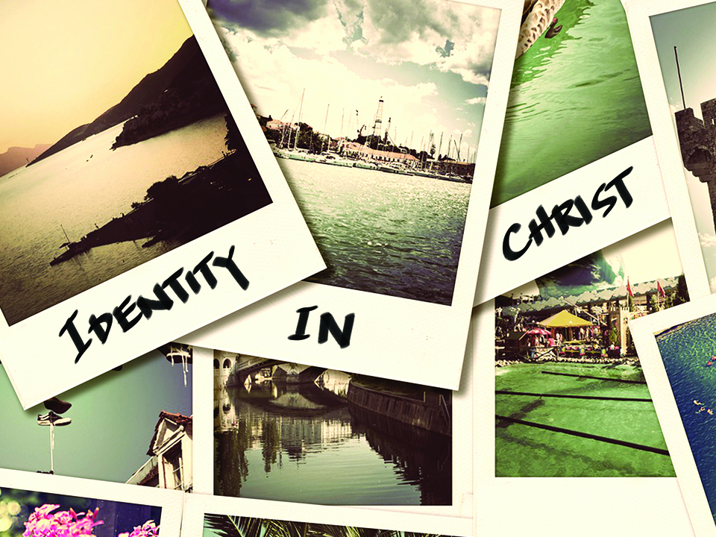
NKJV

Slide 2

I have been crucified with Christ; it is no longer I who live, but Christ lives in me; and the life which I now live in the flesh I live by faith in the Son of God, who loved me and gave Himself for me.
Galatians 2:20
NKJV

Slide 3
MY IDENTITY IS DETERMINED BY MY CHOICES AND MY ENVIRONMENT.
NKJV

Slide 4
THE TRUEST FORM OF OUR IDENTITY WILL ONLY BE FOUND IN A RELATIONSHIP WITH JESUS CHRIST.
NKJV

Slide 5
TEMPLATE
•
•
•
NKJV

