Slide 1
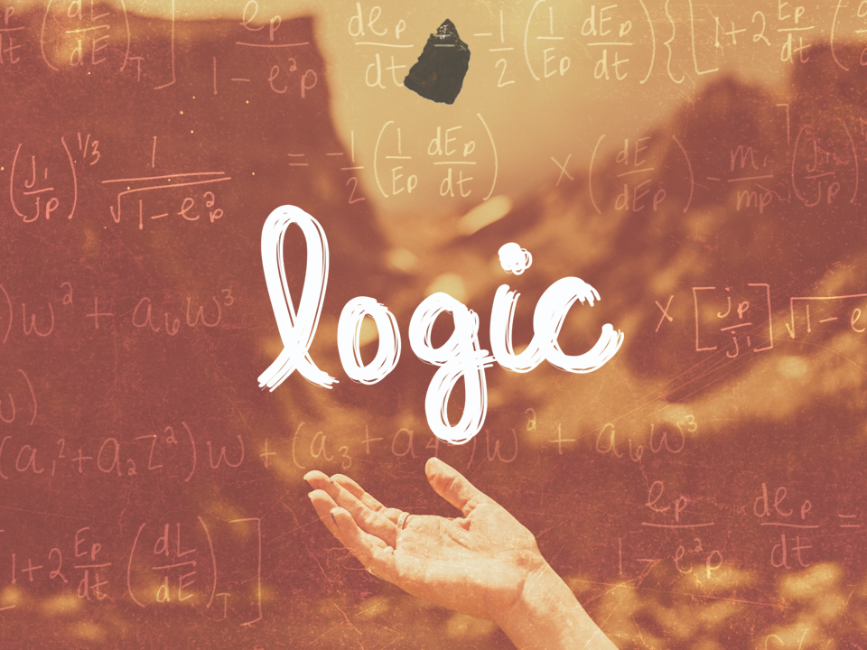
ESV

Slide 2

So that we may no longer be children, tossed to and fro by the waves and carried about by every wind of doctrine, by human cunning, by craftiness in deceitful schemes. Rather, speaking the truth in love, we are to grow up in every way into Him who is the head, into Christ.
^{Ephesians 4:14-15}
ESV

Slide 3
Logic is not essential in the search for truth.
ESV

Slide 4
Logic is a vital tool in the search for truth.
ESV

Slide 5
TEMPLATE
•
•
•
ESV

