Slide 1
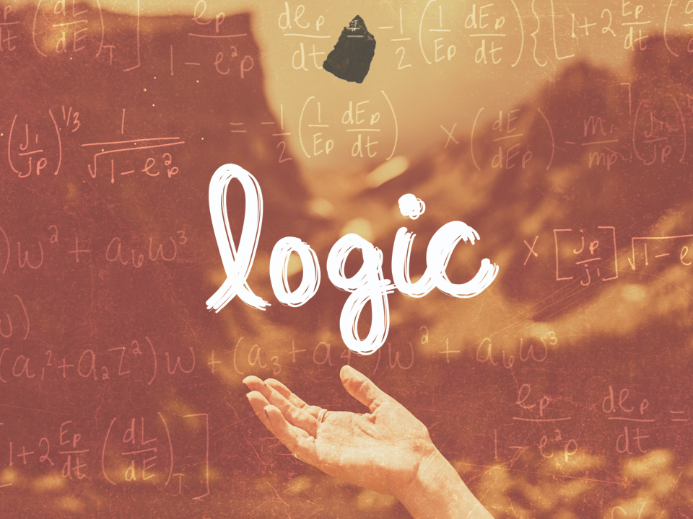
ESV

Slide 2

Then we will no longer be infants, tossed back and forth by the waves, and blown here and there by every wind of teaching and by the cunning and craftiness of men in their deceitful scheming. Instead, speaking the truth in love, we will in all things grow up into Him who is the Head, that is, Christ.
^{Ephesians 4:14-15}
NIV

Slide 3
Logic is not essential in the search for truth.
NIV

Slide 4
Logic is a vital tool in the search for truth.
NIV

Slide 5
TEMPLATE
•
•
•
NIV

