Slide 1
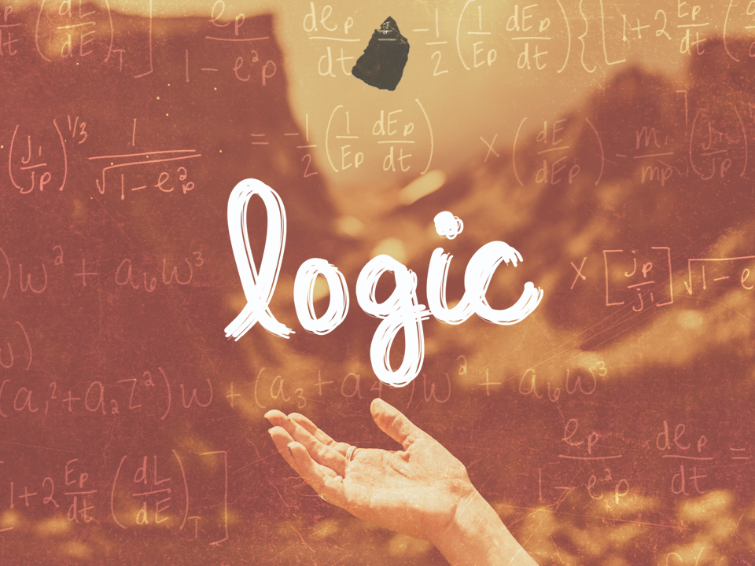
ESV

Slide 2

That we should no longer be children, tossed to and fro and carried about with every wind of doctrine, by the trickery of men, in the cunning craftiness of deceitful plotting, but, speaking the truth in love, may grow up in all things into Him who is the head — Christ.
^{Ephesians 4:14-15}
NKJV

Slide 3
Logic is not essential in the search for truth.
NKJV

Slide 4
Logic is a vital tool in the search for truth.
NKJV

Slide 5
TEMPLATE
•
•
•
NKJV

