Slide 1
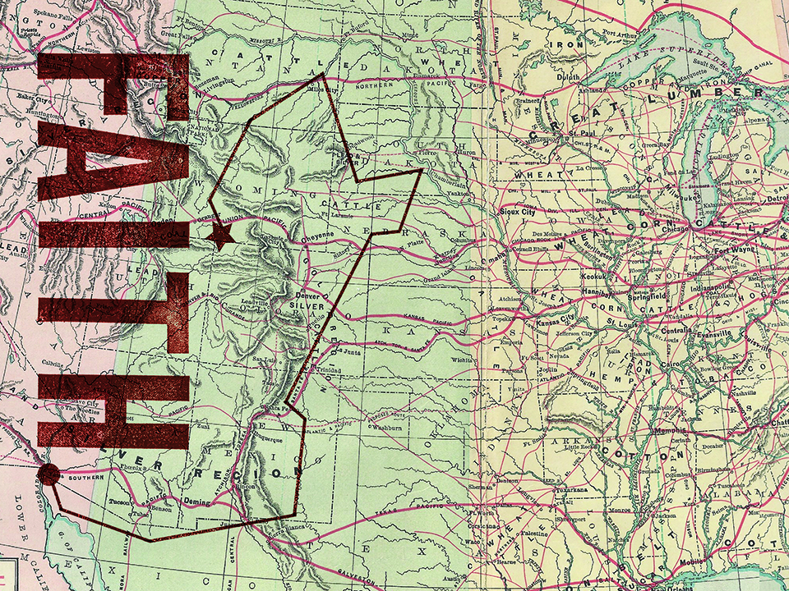
ESV

Slide 2
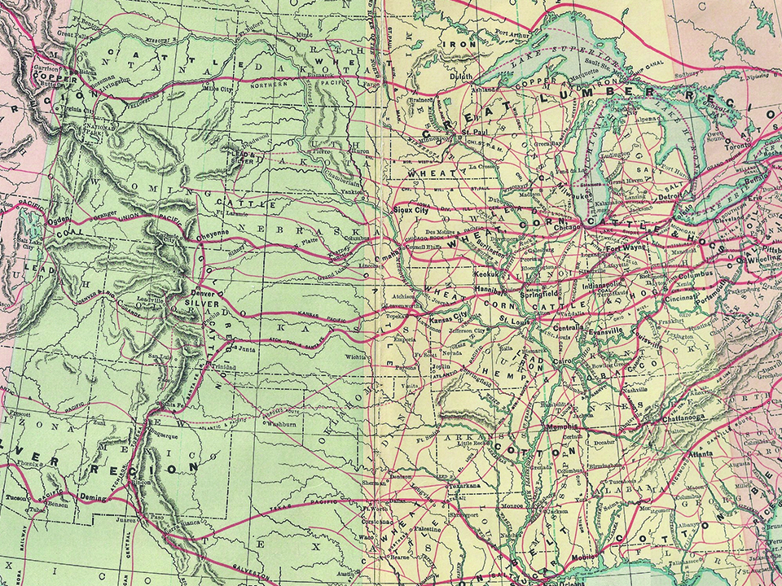
And without faith it is impossible to please Him, for whoever would draw near to God must believe that He exists and that He rewards those who seek Him.
Hebrews 11:6
ESV

Slide 3
I OBEY GOD BECAUSE
I HAVE TO DO WHAT
HE SAYS.
ESV

Slide 4
I OBEY GOD BECAUSE I TRUST HIM.
ESV

Slide 5
TEMPLATE
•
•
•
ESV

