Slide 1
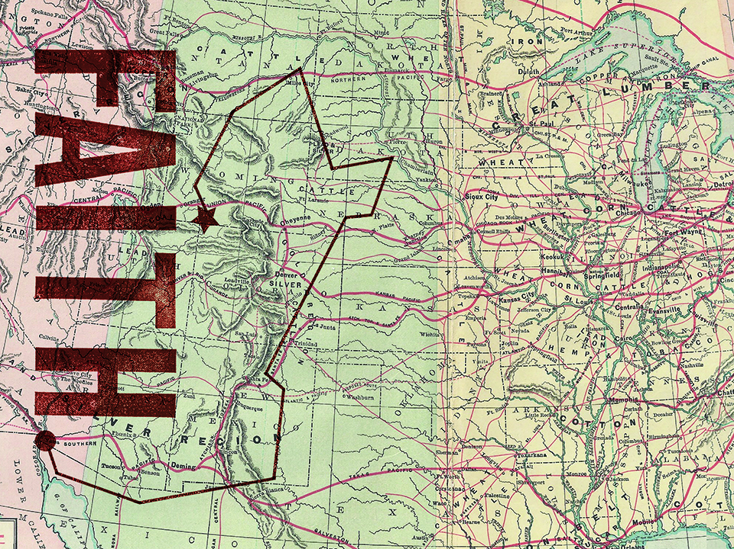
NIV

Slide 2
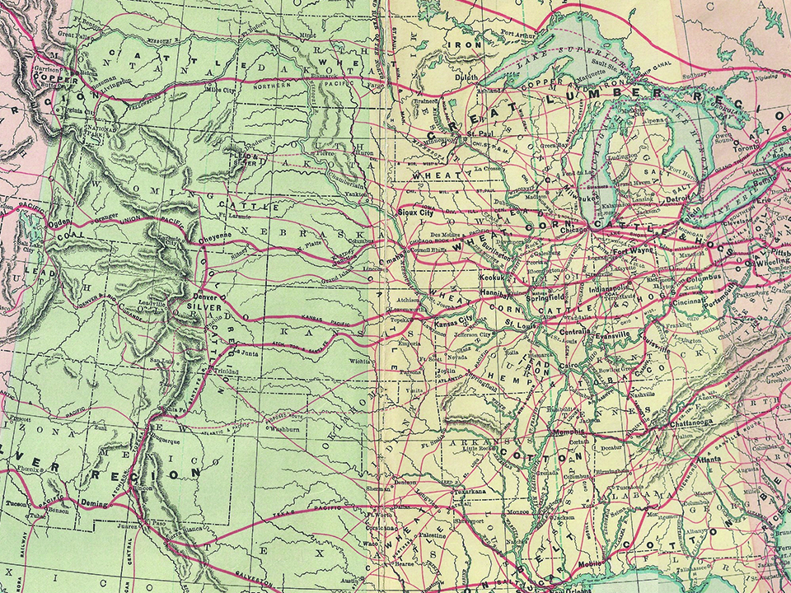
And without faith it is impossible to please God, because anyone who comes to Him must believe that He exists and that He rewards those who earnestly seek Him.
Hebrews 11:6
NIV

Slide 3
I OBEY GOD BECAUSE
I HAVE TO DO WHAT
HE SAYS.
NIV

Slide 4
I OBEY GOD BECAUSE I TRUST HIM.
NIV

Slide 5
TEMPLATE
•
•
•
NIV

