Slide 1
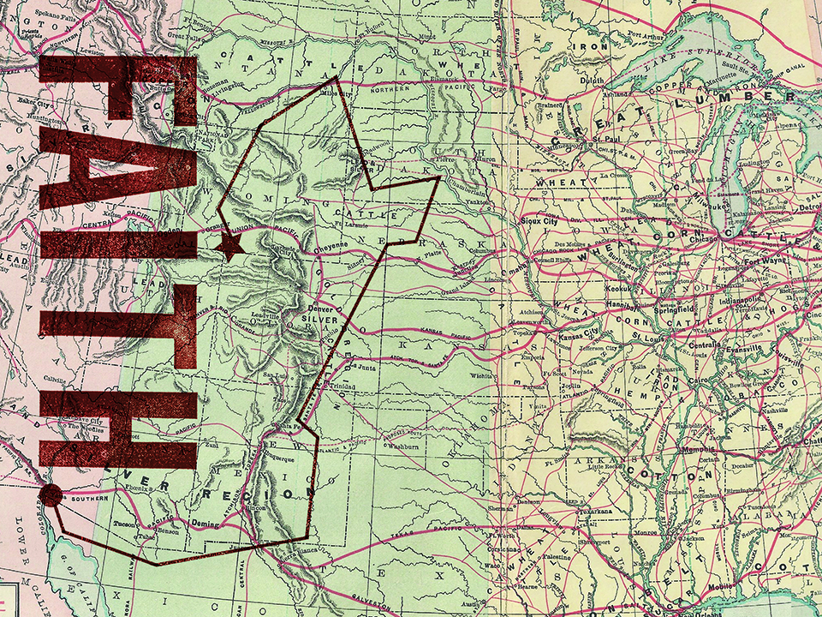
NKJV

Slide 2
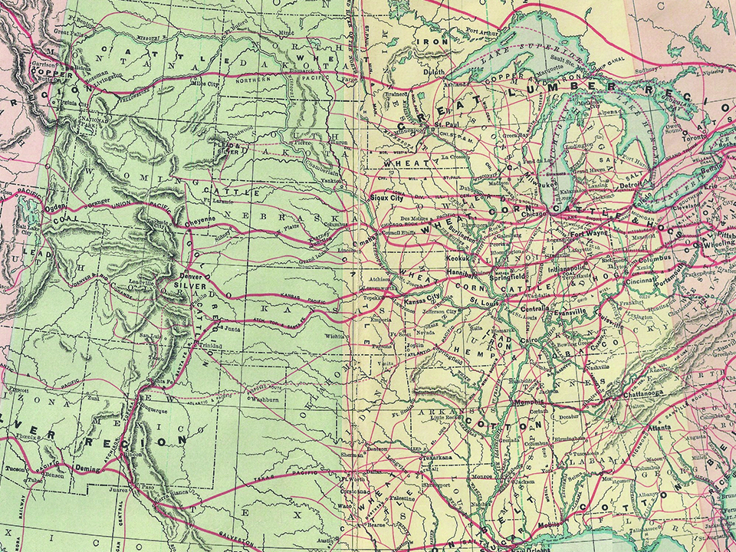
But without faith it is impossible to please Him, for he who comes to God must believe that He is, and that He is a rewarder of those who diligently seek Him.
Hebrews 11:6
NKJV

Slide 3
I OBEY GOD BECAUSE
I HAVE TO DO WHAT
HE SAYS.
NKJV

Slide 4
I OBEY GOD BECAUSE I TRUST HIM.
NKJV

Slide 5
TEMPLATE
•
•
•
NKJV

