Slide 1
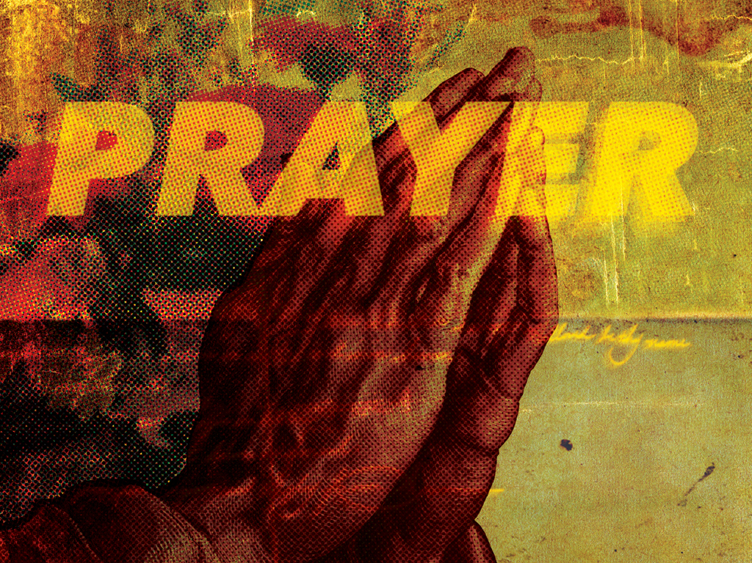
KJV

Slide 2

After this manner therefore pray ye: “Our Father which art in heaven, hallowed be Thy name. Thy kingdom come. Thy will be done in earth, as it is in heaven. Give us this day our daily bread. And forgive us our debts, as we forgive our debtors. And lead us not into temptation, but deliver us from evil: For Thine is the kingdom, and the power, and the glory, forever. Amen.”
Matthew 6:9-13
KJV

Slide 3
I ONLY TALK TO
GOD WHEN I NEED SOMETHING.
KJV

Slide 4
PRAYER IS A CONVERSATION. IT’S MORE THAN JUST TALKING. WE LISTEN TO GOD’S RESPONSES IN HIS WORD.
KJV

Slide 5
TEMPLATE
•
•
•
KJV

