Slide 1
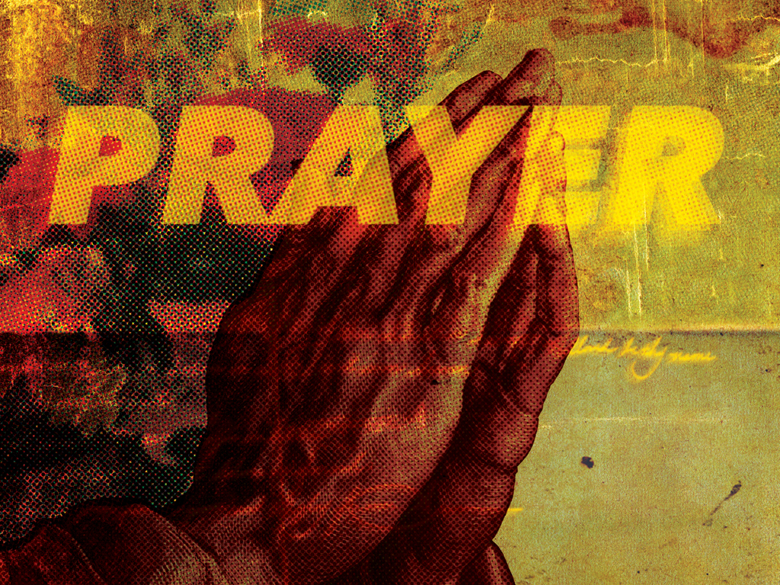
NKJV

Slide 2

In this manner, therefore, pray: Our Father in heaven, Hallowed be Your name. Your kingdom come. Your will be done On earth as it is in heaven. Give us this day our daily bread. And forgive us our debts, As we forgive our debtors. And do not lead us into temptation, But deliver us from the evil one. For Yours is the kingdom and the power and the glory forever. Amen.
Matthew 6:9-13
NKJV

Slide 3
I ONLY TALK TO GOD WHEN I NEED SOMETHING.
NKJV

Slide 4
PRAYER IS A CONVERSATION. IT’S MORE THAN JUST TALKING. WE LISTEN TO GOD’S RESPONSES IN HIS WORD.
NKJV

Slide 5
TEMPLATE
•
•
•
NKJV

