Slide 1
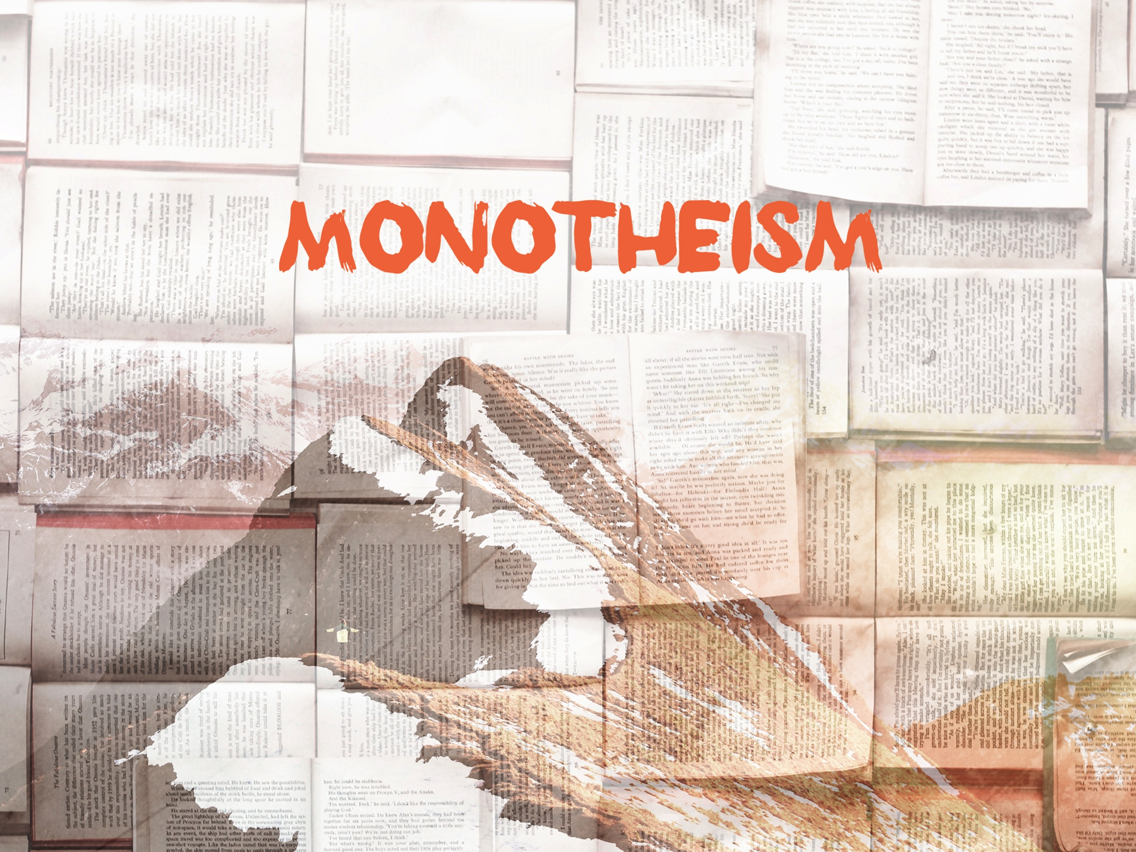
ESV

Slide 2

For the invisible things of Him from the creation of the world are clearly seen, being understood by the things that are made, even His eternal power and Godhead; so that they are without excuse.
^{Romans 1:20}
KJV

Slide 3
Believing in one God is enough.
KJV

Slide 4
God has made Himself known and has expectations for how we should live.
KJV

Slide 5
TEMPLATE
•
•
•
KJV

