Slide 1
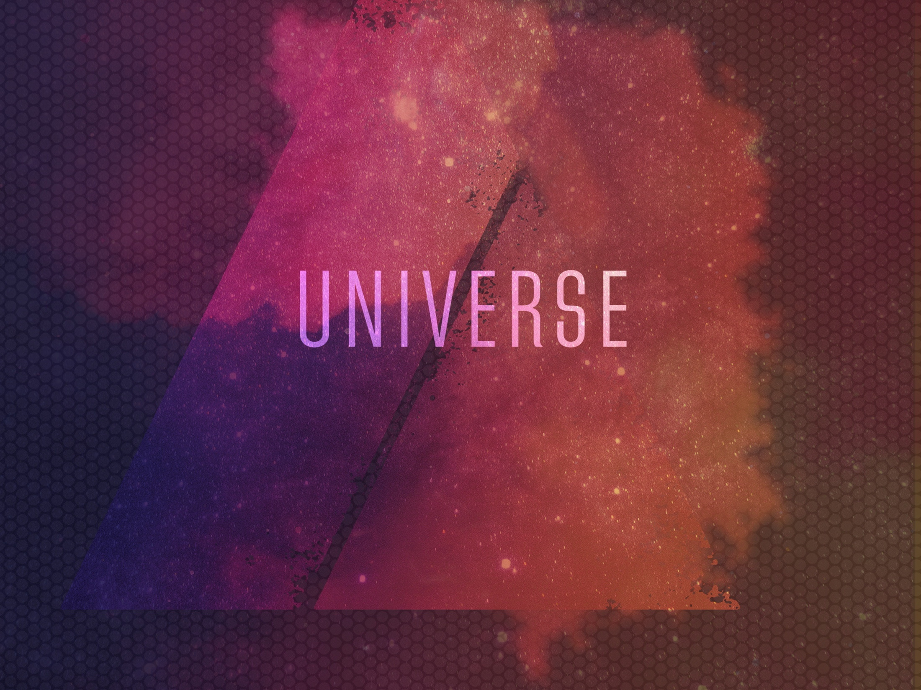
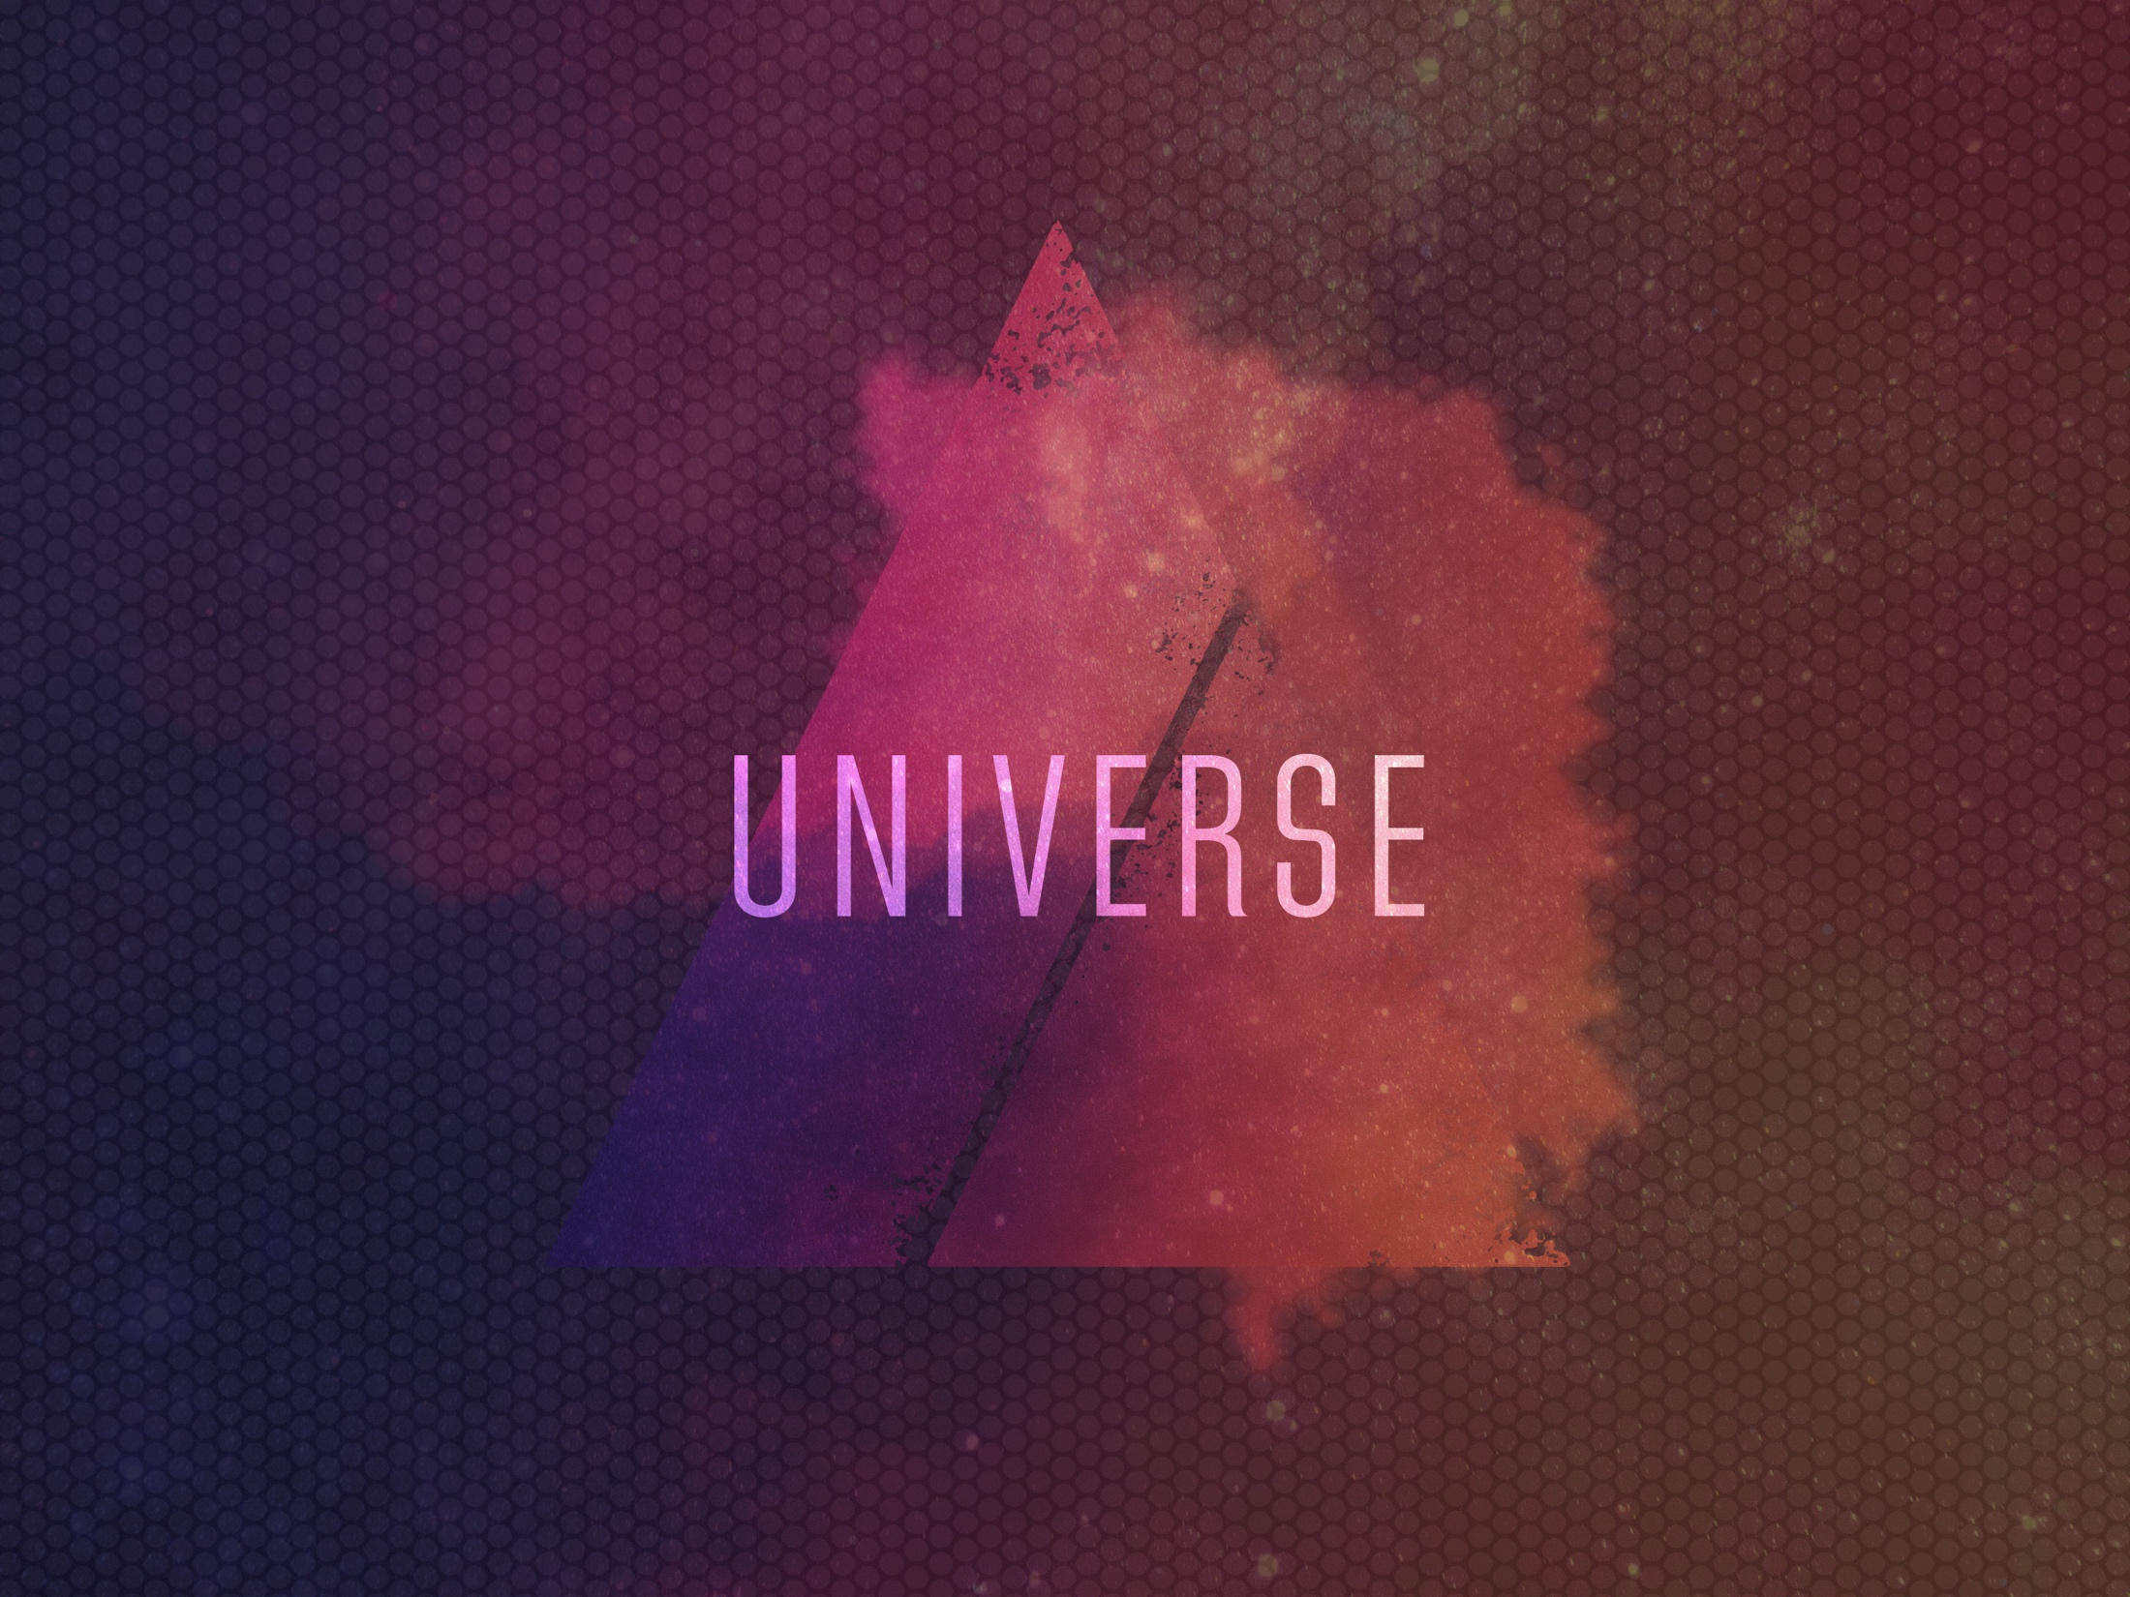
ESV

Slide 2

When I consider Thy heavens, the work of Thy fingers, the moon and the stars, which Thou hast ordained; what is man, that Thou art mindful of him? And the son of man, that Thou visitest him?
^{Psalm 8:3-4}
KJV

Slide 3
The physical laws that govern our universe can be explained through purely natural means.
KJV

Slide 4
The fine-tuning of the universe is one evidence from nature that points toward a designer.
KJV

Slide 5
TEMPLATE
•
•
•
KJV

