Slide 1
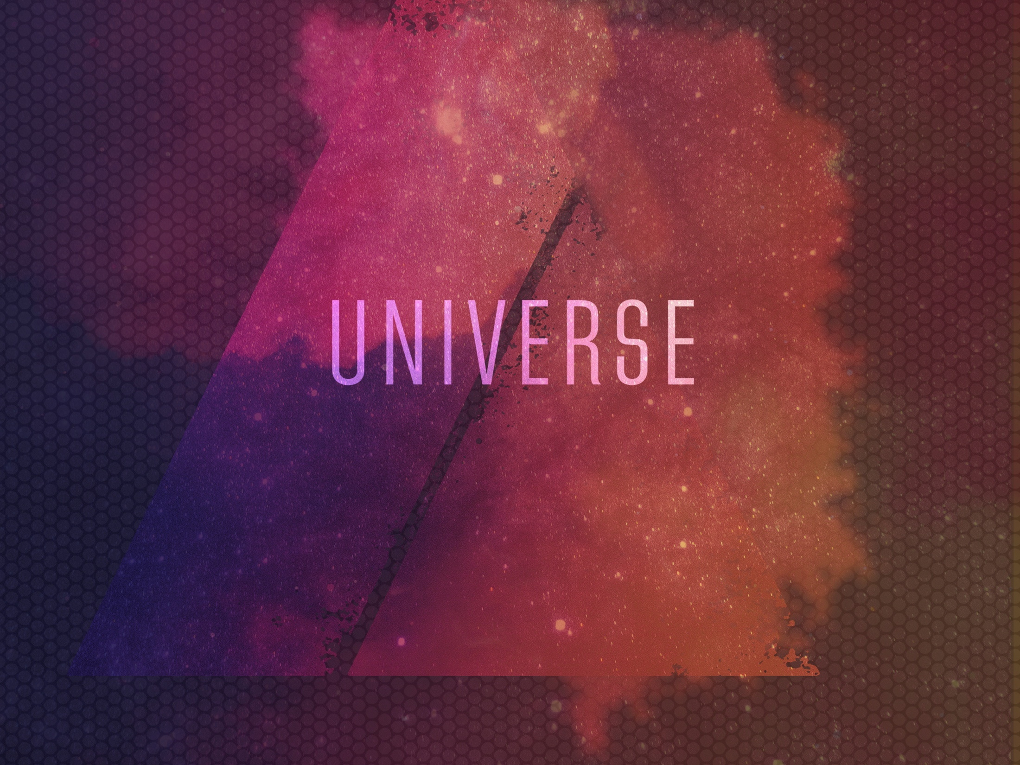
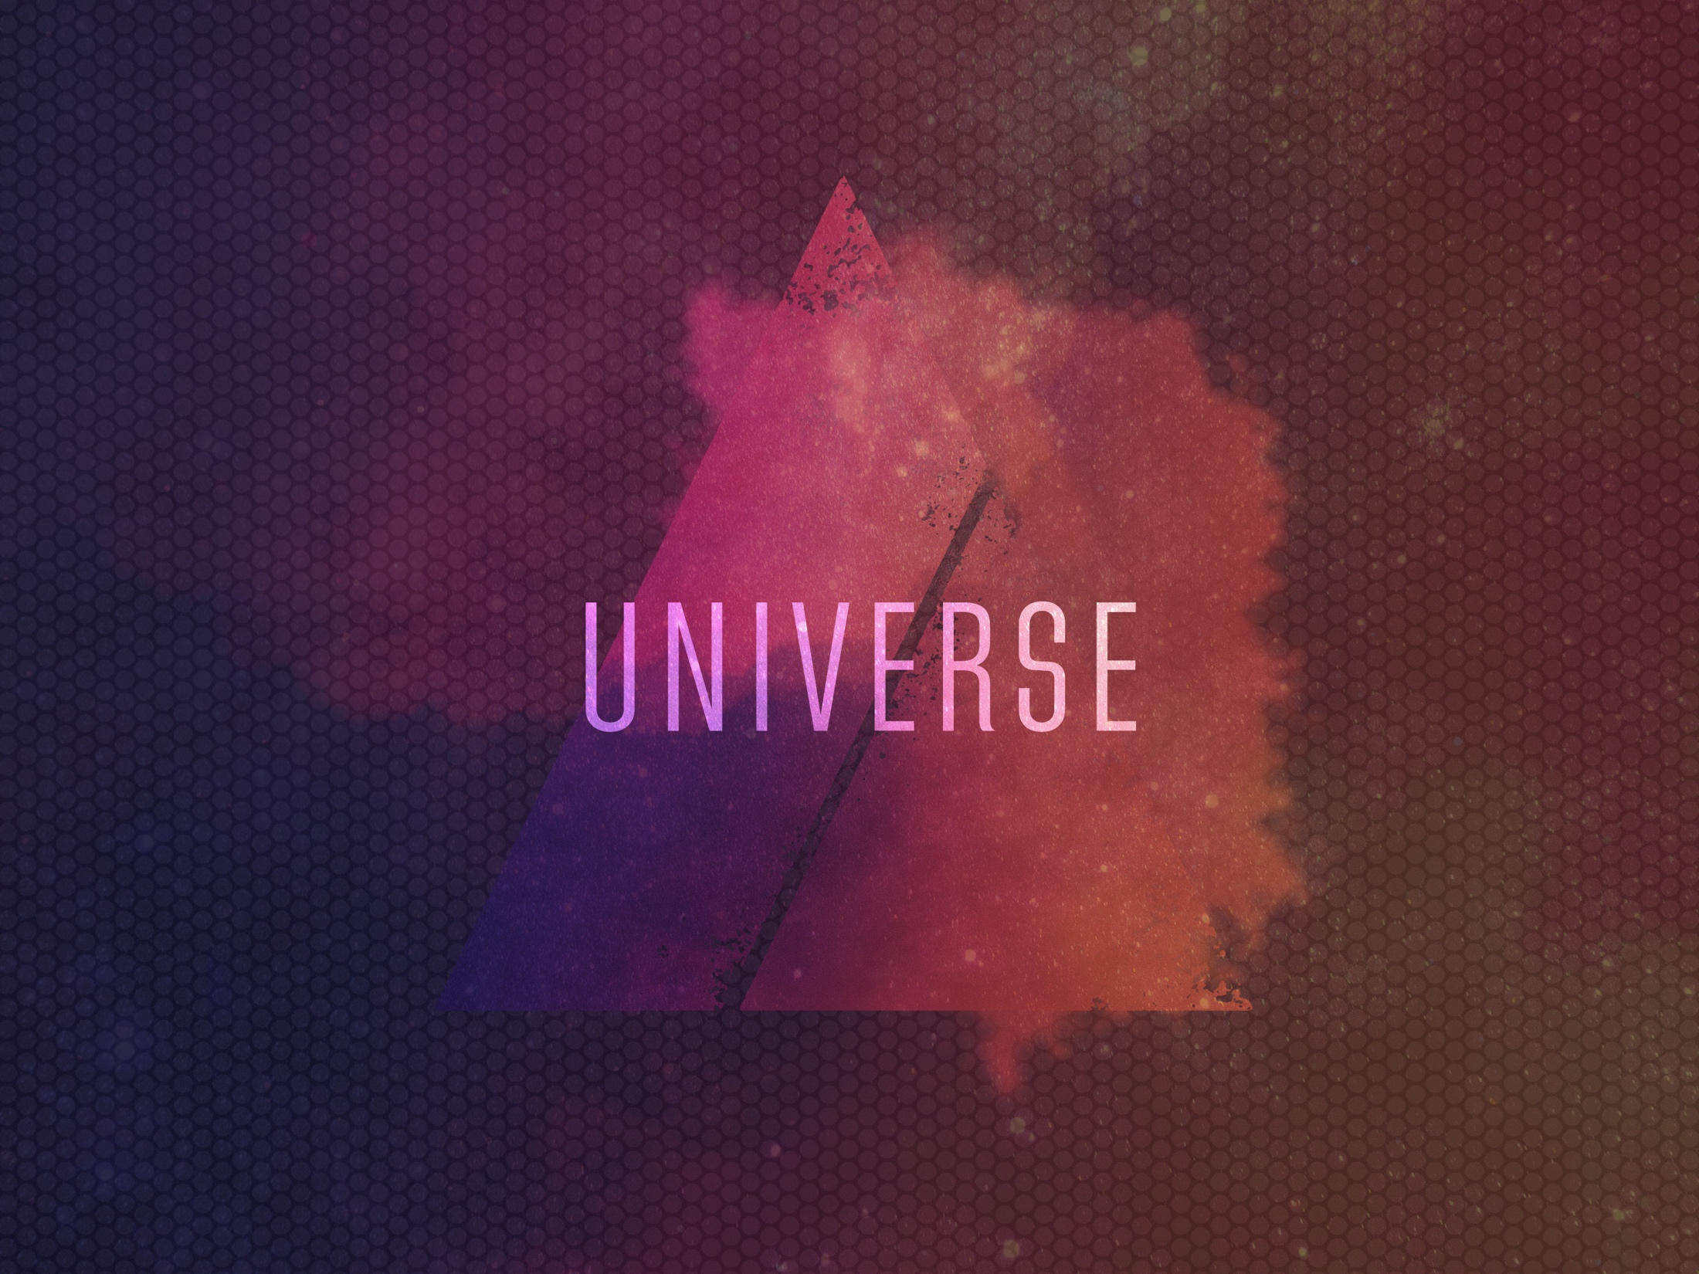
ESV

Slide 2

When I consider Your heavens, the work of Your fingers, the moon and the stars, which You have ordained, what is man that You are mindful of him, and the son of man that You visit him?
^{Psalm 8:3-4}
NKJV

Slide 3
The physical laws that govern our universe can be explained through purely natural means.
NKJV

Slide 4
The fine-tuning of the universe is one evidence from nature that points toward a designer.
NKJV

Slide 5
TEMPLATE
•
•
•
NKJV

