Slide 1
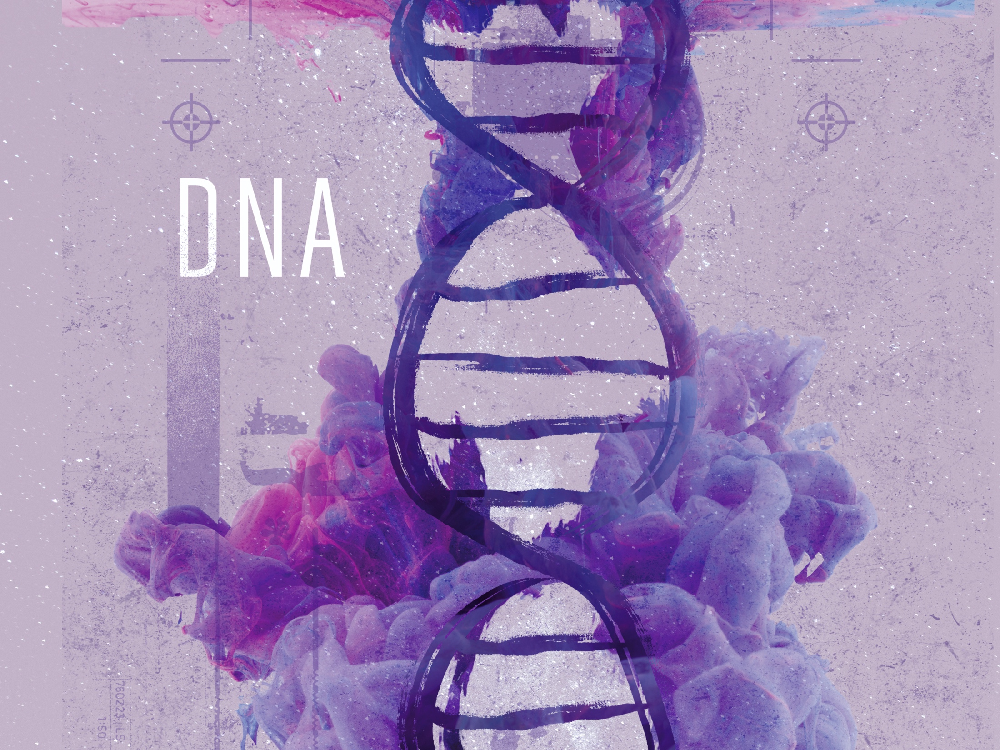
ESV

Slide 2

For You created my inmost being; You knit me together in my mother’s womb. I praise You because I am fearfully and wonderfully made; Your works are wonderful, I know that full well.
^{Psalm 139:13-14}
NIV

Slide 3
The information in DNA could result from a process of pure chance.
NIV

Slide 4
The information in DNA points to an author of life.
NIV

Slide 5
TEMPLATE
•
•
•
NIV

