Slide 1

ESV

Slide 2
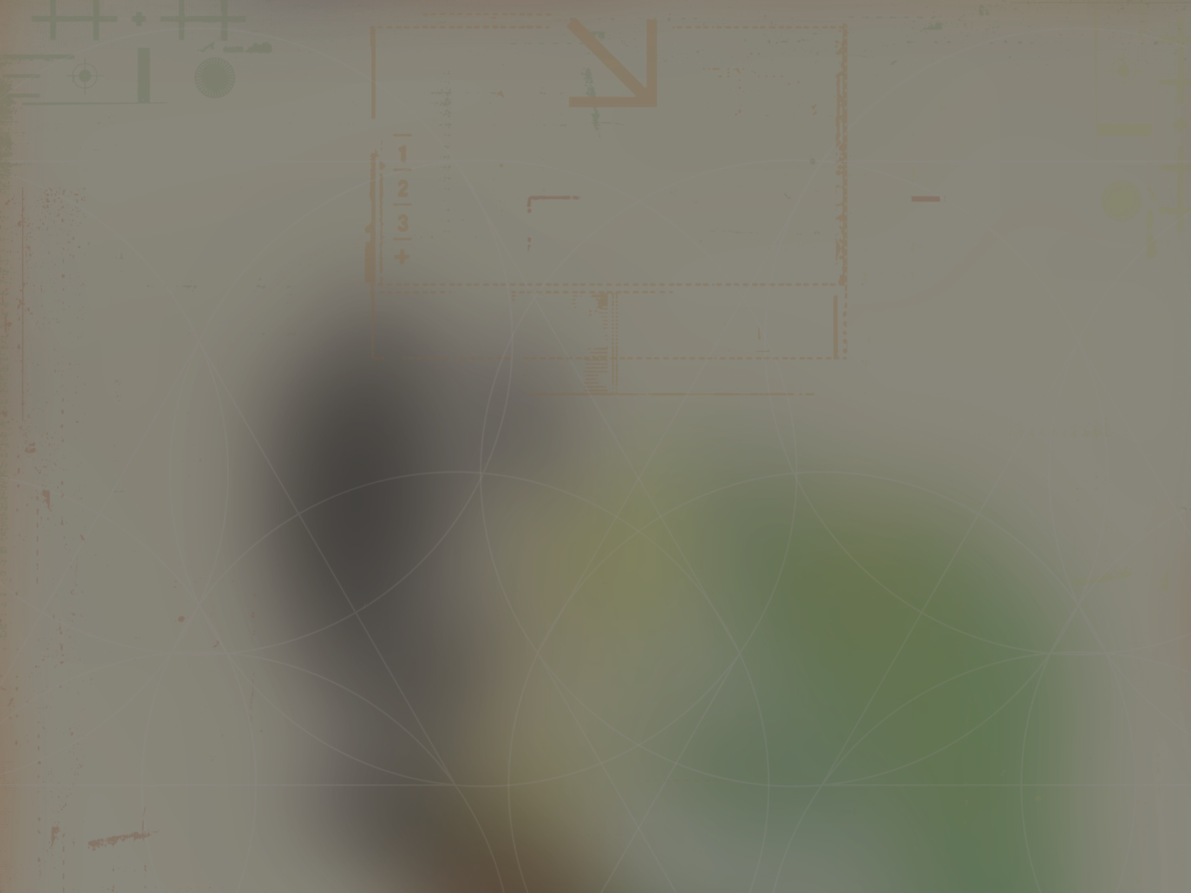
The heavens declare the glory of God, and the sky above proclaims His handiwork. Day to day pours out speech, and night to night reveals knowledge.
^{Psalm 19:1-2}
ESV

Slide 3
The complex patterns of the universe can be explained without a designer.
ESV

Slide 4
The complex patterns of the universe are best explained by an intelligent designer, confirming a theistic worldview.
ESV

Slide 5
TEMPLATE
•
•
•
ESV

