Slide 1

ESV

Slide 2
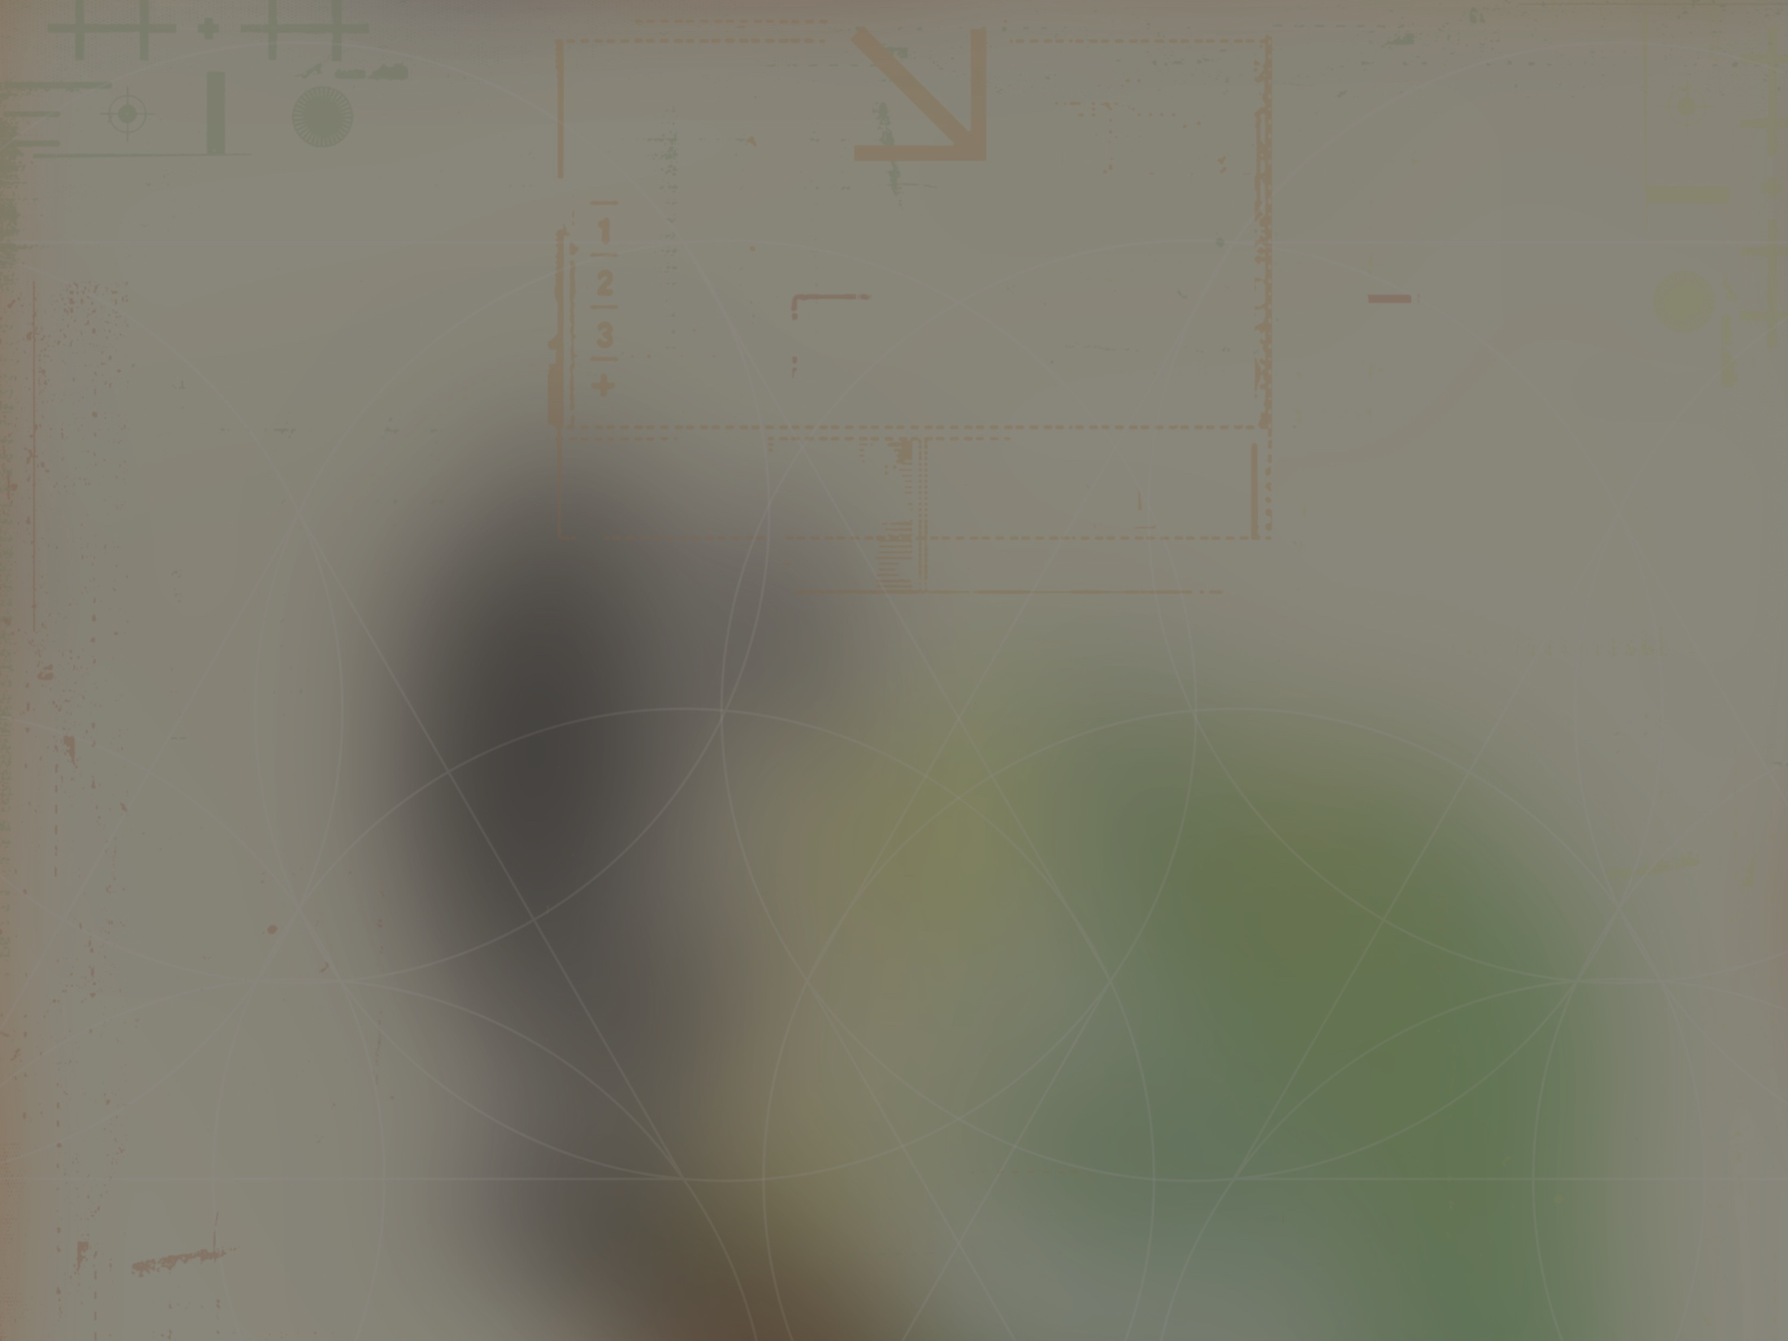
The heavens declare the glory of God; the skies proclaim the work of His hands. Day after day they pour forth speech; night after night they display knowledge.
^{Psalm 19:1-2}
NIV

Slide 3
The complex patterns of the universe can be explained without a designer.
NIV

Slide 4
The complex patterns of the universe are best explained by an intelligent designer, confirming a theistic worldview.
NIV

Slide 5
TEMPLATE
•
•
•
NIV

