Slide 1
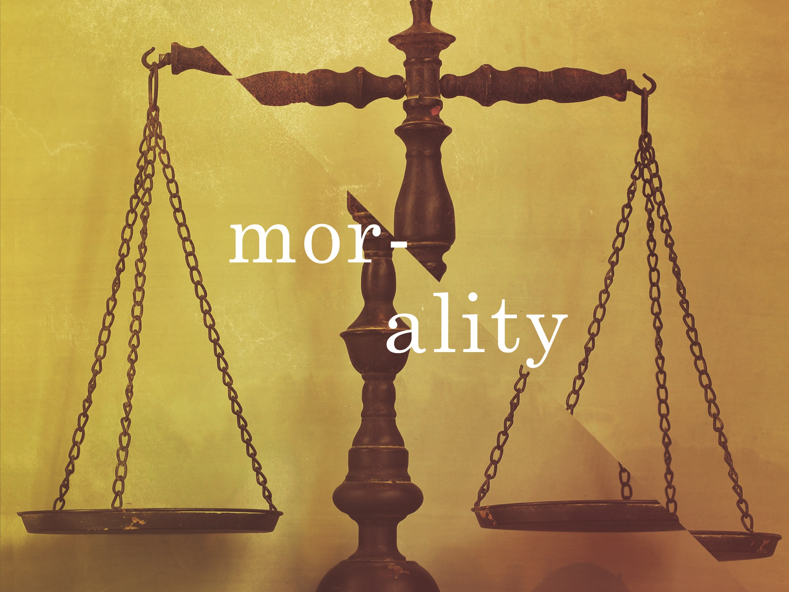
ESV

Slide 2

(Indeed, when Gentiles, who do not have the law, do by nature things required by the law, they are a law for themselves, even though they do not have the law, since they show that the requirements of the law are written on their hearts, their consciences also bearing witness, and their thoughts now accusing, now even defending them.)
^{Romans 2:14-15}
NIV

Slide 3
Morality is subjectively determined by each individual.
NIV

Slide 4
The existence of universal right and wrong is evidence of a moral lawgiver.
NIV

Slide 5
TEMPLATE
•
•
•
NIV

