Slide 1
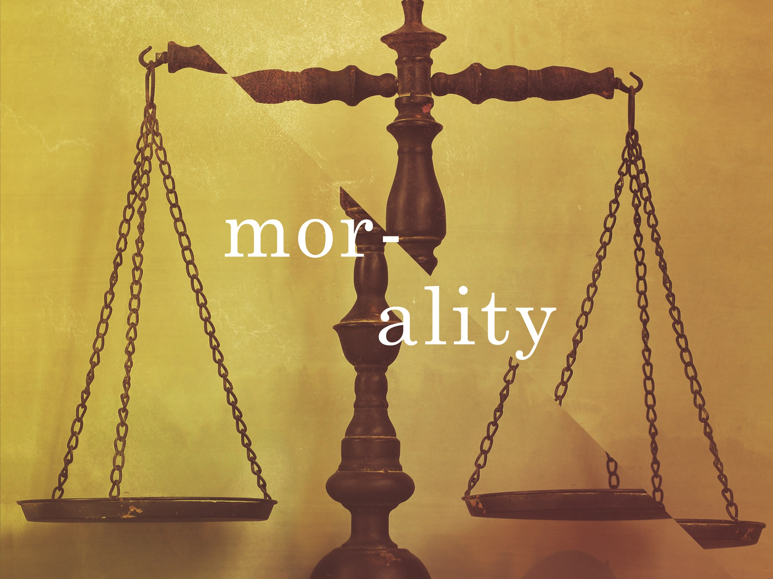
ESV

Slide 2

For when Gentiles, who do not have the law, by nature do the things in the law, these, although not having the law, are a law to themselves, who show the work of the law written in their hearts, their conscience also bearing witness, and between themselves their thoughts accusing or else excusing them.
^{Romans 2:14-15}
NKJV

Slide 3
Morality is subjectively determined by each individual.
NKJV

Slide 4
The existence of universal right and wrong is evidence of a moral lawgiver.
NKJV

Slide 5
TEMPLATE
•
•
•
NKJV

