Slide 1
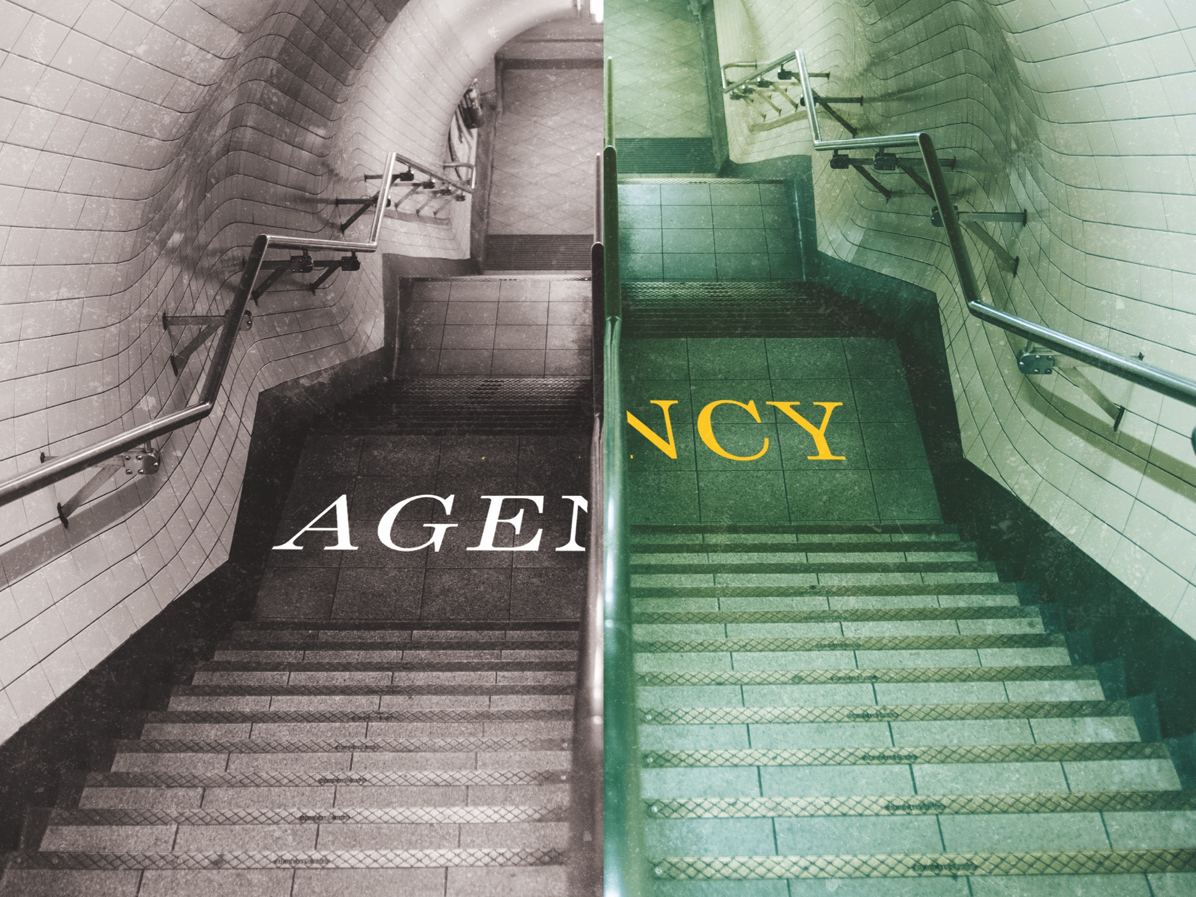
ESV

Slide 2

Therefore everyone who hears these words of Mine and puts them into practice is like a wise man who built his house on the rock. The rain came down, the streams rose, and the winds blew and beat against that house; yet it did not fall, because it had its foundation on the rock.
^{Matthew 7:24-25}
NIV

Slide 3
Humans are merely the product of their genes and environment.
NIV

Slide 4
Our ability to choose is evidence of a supreme agent to whom we are accountable.
NIV

Slide 5
TEMPLATE
•
•
•
NIV

