Slide 1
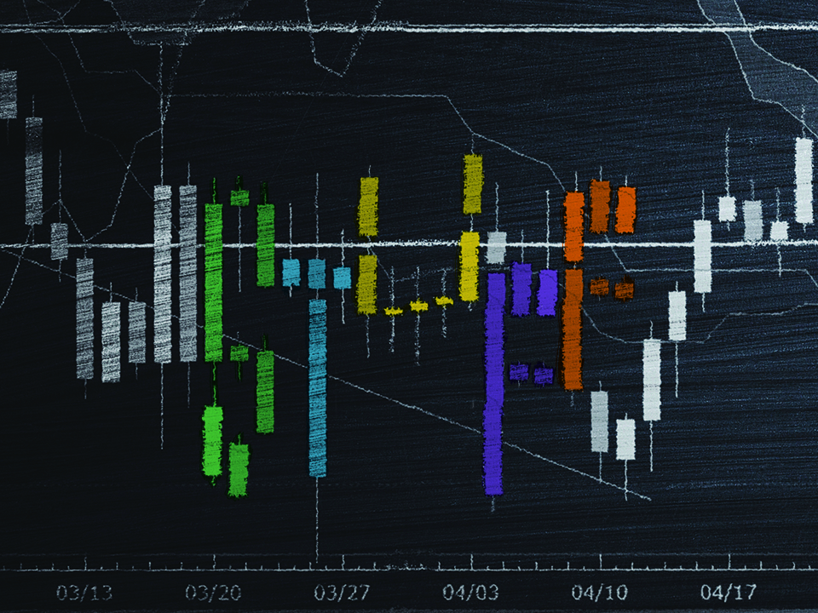
KJV

Slide 2
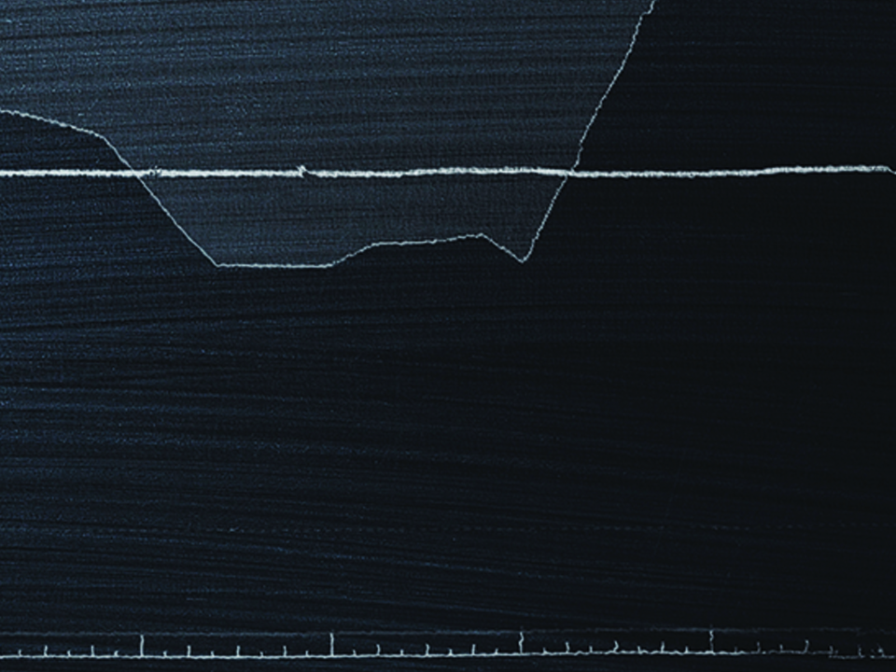
But lay up for yourselves treasures in heaven, where neither moth nor rust doth corrupt, and where thieves do not break through nor steal: for where your treasure is, there
will your heart be also.
Matthew 6:20-21
KJV

Slide 3
I DETERMINE THE VALUE OF EVERYTHING.
KJV

Slide 4
GOD DOES NOT VALUE WHAT THE WORLD VALUES.
KJV

Slide 5
TEMPLATE
•
•
•
KJV

