Slide 1
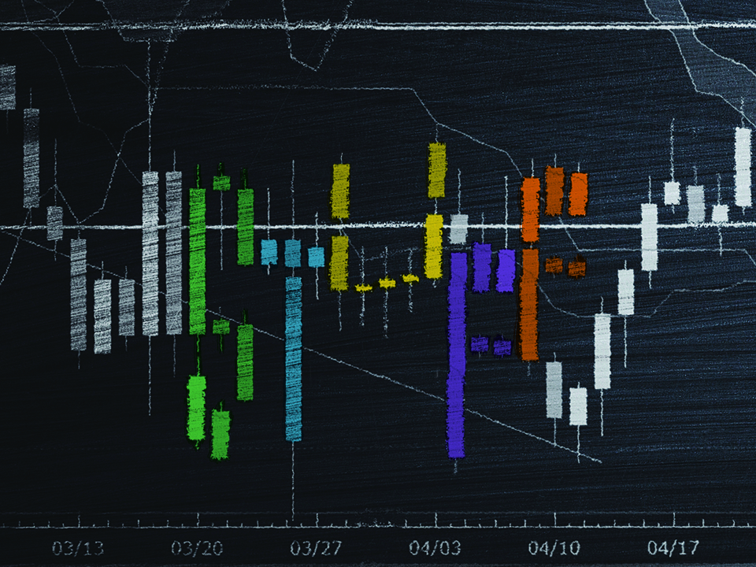
NIV

Slide 2
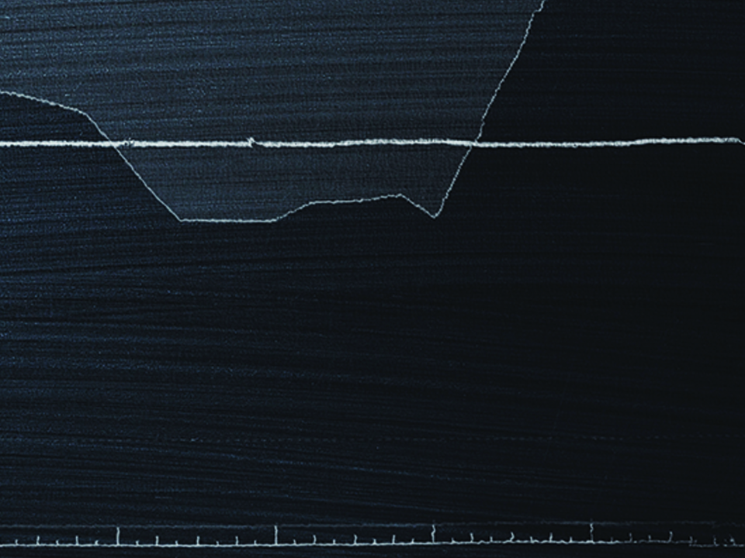
But store up for yourselves treasures in heaven, where moth and rust do not destroy, and where thieves do not break in and steal. For where your treasure is, there your heart will be also.
Matthew 6:20-21
NIV

Slide 3
I DETERMINE THE VALUE OF EVERYTHING.
NIV

Slide 4
GOD DOES NOT VALUE WHAT THE WORLD VALUES.
NIV

Slide 5
TEMPLATE
•
•
•
NIV

