Slide 1
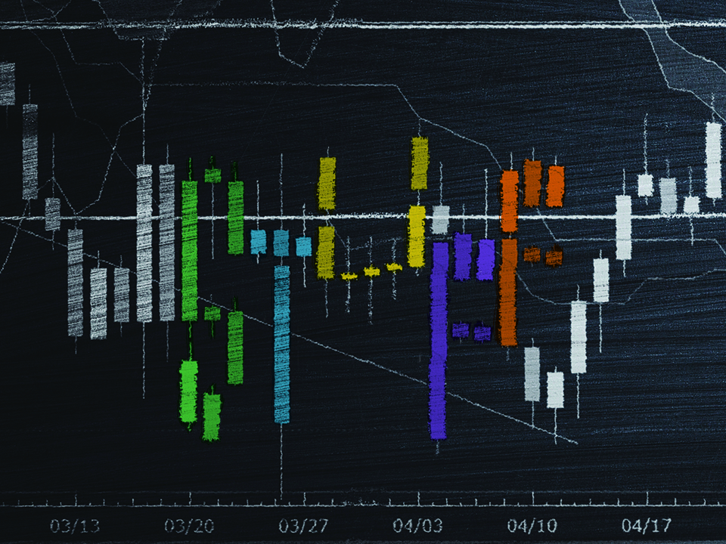
NKJV

Slide 2
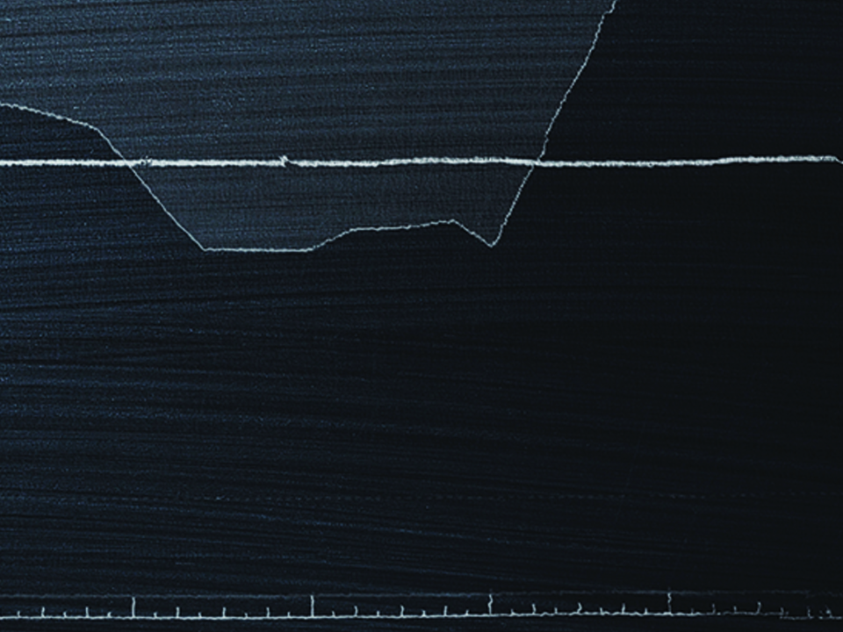
But lay up for yourselves treasures in heaven, where neither moth nor rust destroys and where thieves do not break in and steal. For where your treasure is, there your heart will be also.
Matthew 6:20-21
NKJV

Slide 3
I DETERMINE THE VALUE OF EVERYTHING.
NKJV

Slide 4
GOD DOES NOT VALUE WHAT THE WORLD VALUES.
NKJV

Slide 5
TEMPLATE
•
•
•
NKJV

