Slide 1
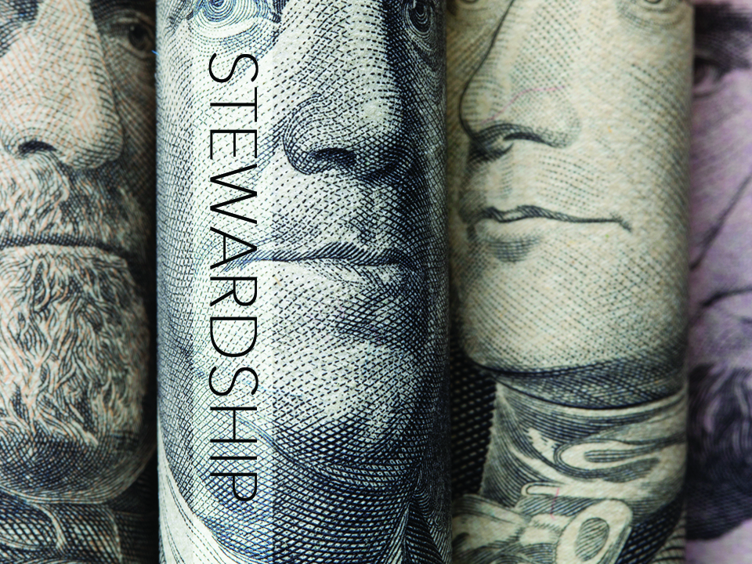
KJV

Slide 2

For unto every one that hath shall be given, and he shall have abundance: but from him that hath not shall be taken away even
that which he hath.
Matthew 25:29
KJV

Slide 3
MY PURPOSE AND MY TREASURE BELONG TO ME.
KJV

Slide 4
GOD EXPECTS US TO TAKE RESPONSIBILITY FOR ALL THAT HE
GAVE US.
KJV

Slide 5
TEMPLATE
•
•
•
KJV

