Slide 1
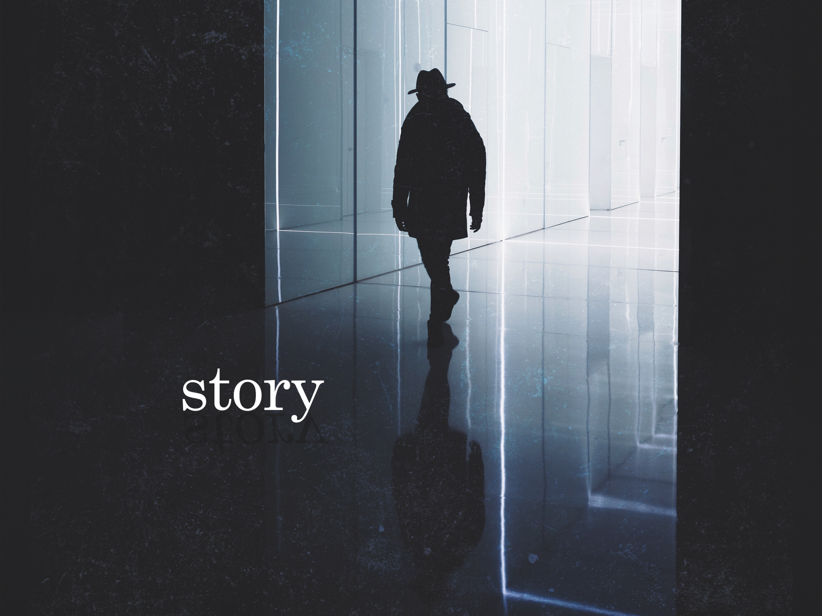
ESV

Slide 2

I will open my mouth in a parable; I will utter dark sayings of old, which we have heard and known, and our fathers have told us. We will not hide them from their children, telling to the generation to come the praises of the LORD, and His strength and His wonderful works that He has done.
^{Psalm 78:2-4}
NKJV

Slide 3
Our stories are not connected to a greater story beyond ourselves.
NKJV

Slide 4
Our storytelling nature points to a creative author who has made us part of His grand narrative.
NKJV

Slide 5
TEMPLATE
•
•
•
NKJV

