Slide 1
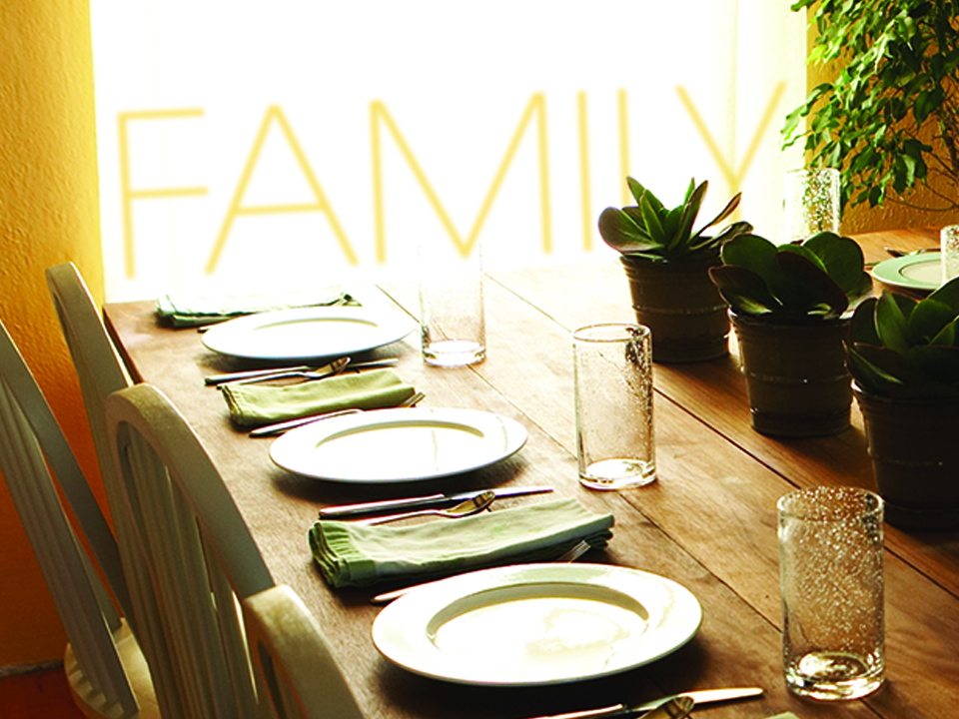
KJV

Slide 2

Be kindly affectioned one to another with brotherly love; in honor preferring
one another.
Romans 12:10
KJV

Slide 3
MY FAMILY CIRCLE IS HERE TO HELP ME GET WHERE I WANT TO GO.
KJV

Slide 4
GOD DESIGNED US TO CONTRIBUTE TO OUR FAMILY CIRCLE AS WELL.
KJV

Slide 5
TEMPLATE
•
•
•
KJV

