Slide 1
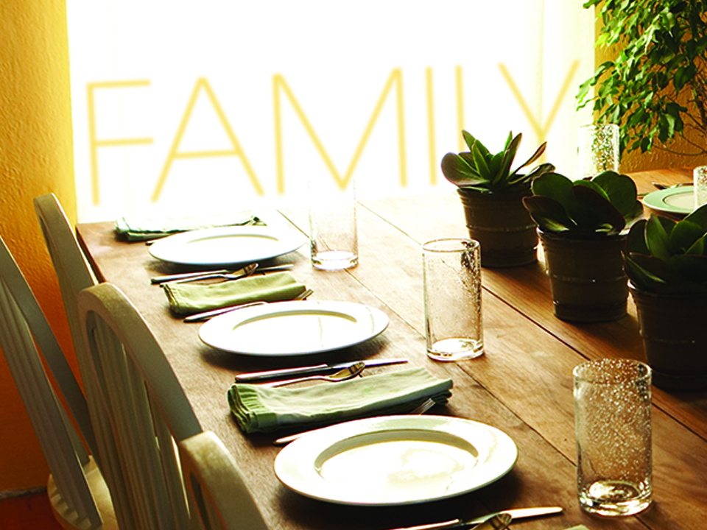
NKJV

Slide 2

Be kindly affectionate to one another with brotherly love, in honor giving preference to one another
Romans 12:10
NKJV

Slide 3
MY FAMILY CIRCLE IS HERE TO HELP ME GET WHERE I WANT TO GO.
NKJV

Slide 4
GOD DESIGNED US TO CONTRIBUTE TO OUR FAMILY CIRCLE AS WELL.
NKJV

Slide 5
TEMPLATE
•
•
•
NKJV

