Slide 1
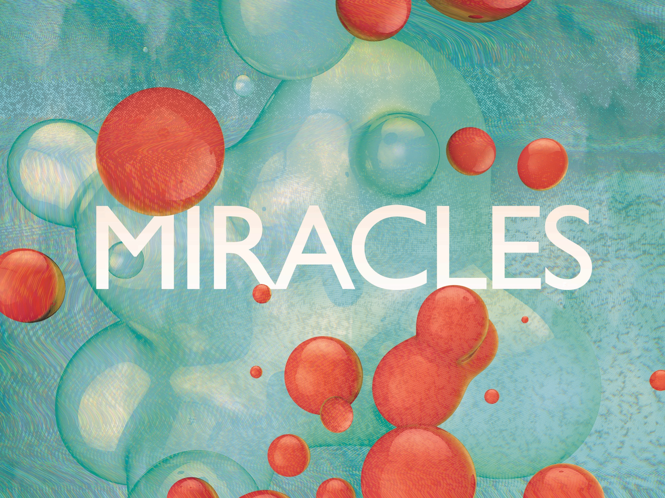
ESV

Slide 2

Your way, O God, is holy. What god is great like our God? You are the God who works wonders; You have made known Your might among the peoples.
^{Psalm 77:13-14}
ESV

Slide 3
Science can explain away miracles.
ESV

Slide 4
Miracles are evidence of the supernatural that cannot be adequately explained away by science alone.
ESV

Slide 5
TEMPLATE
•
•
•
ESV

