Slide 1
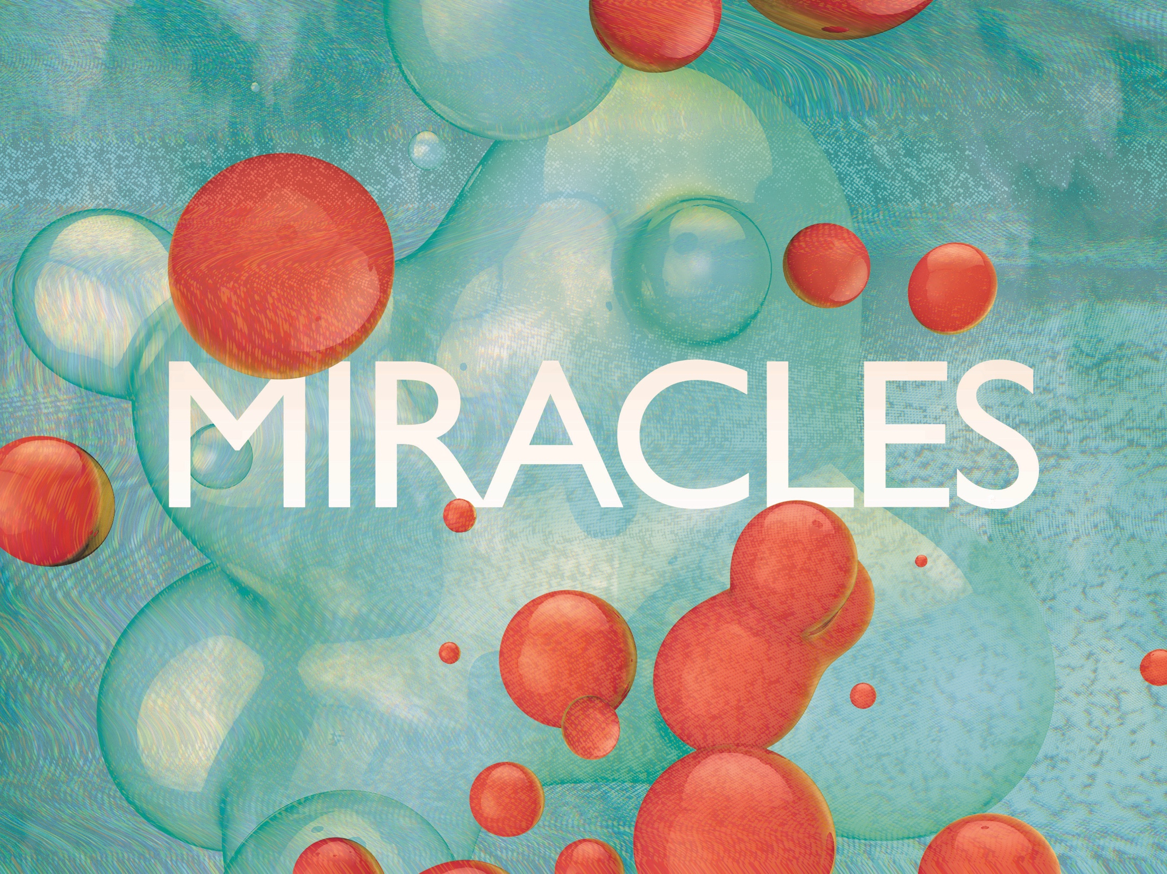
ESV

Slide 2

Thy way, O God, is in the sanctuary: who is so great a God as our God? Thou art the God that doest wonders: Thou hast declared Thy strength among the people.
^{Psalm 77:13-14}
KJV

Slide 3
Science can explain away miracles.
KJV

Slide 4
Miracles are evidence of the supernatural that cannot be adequately explained away by science alone.
KJV

Slide 5
TEMPLATE
•
•
•
KJV

