Slide 1
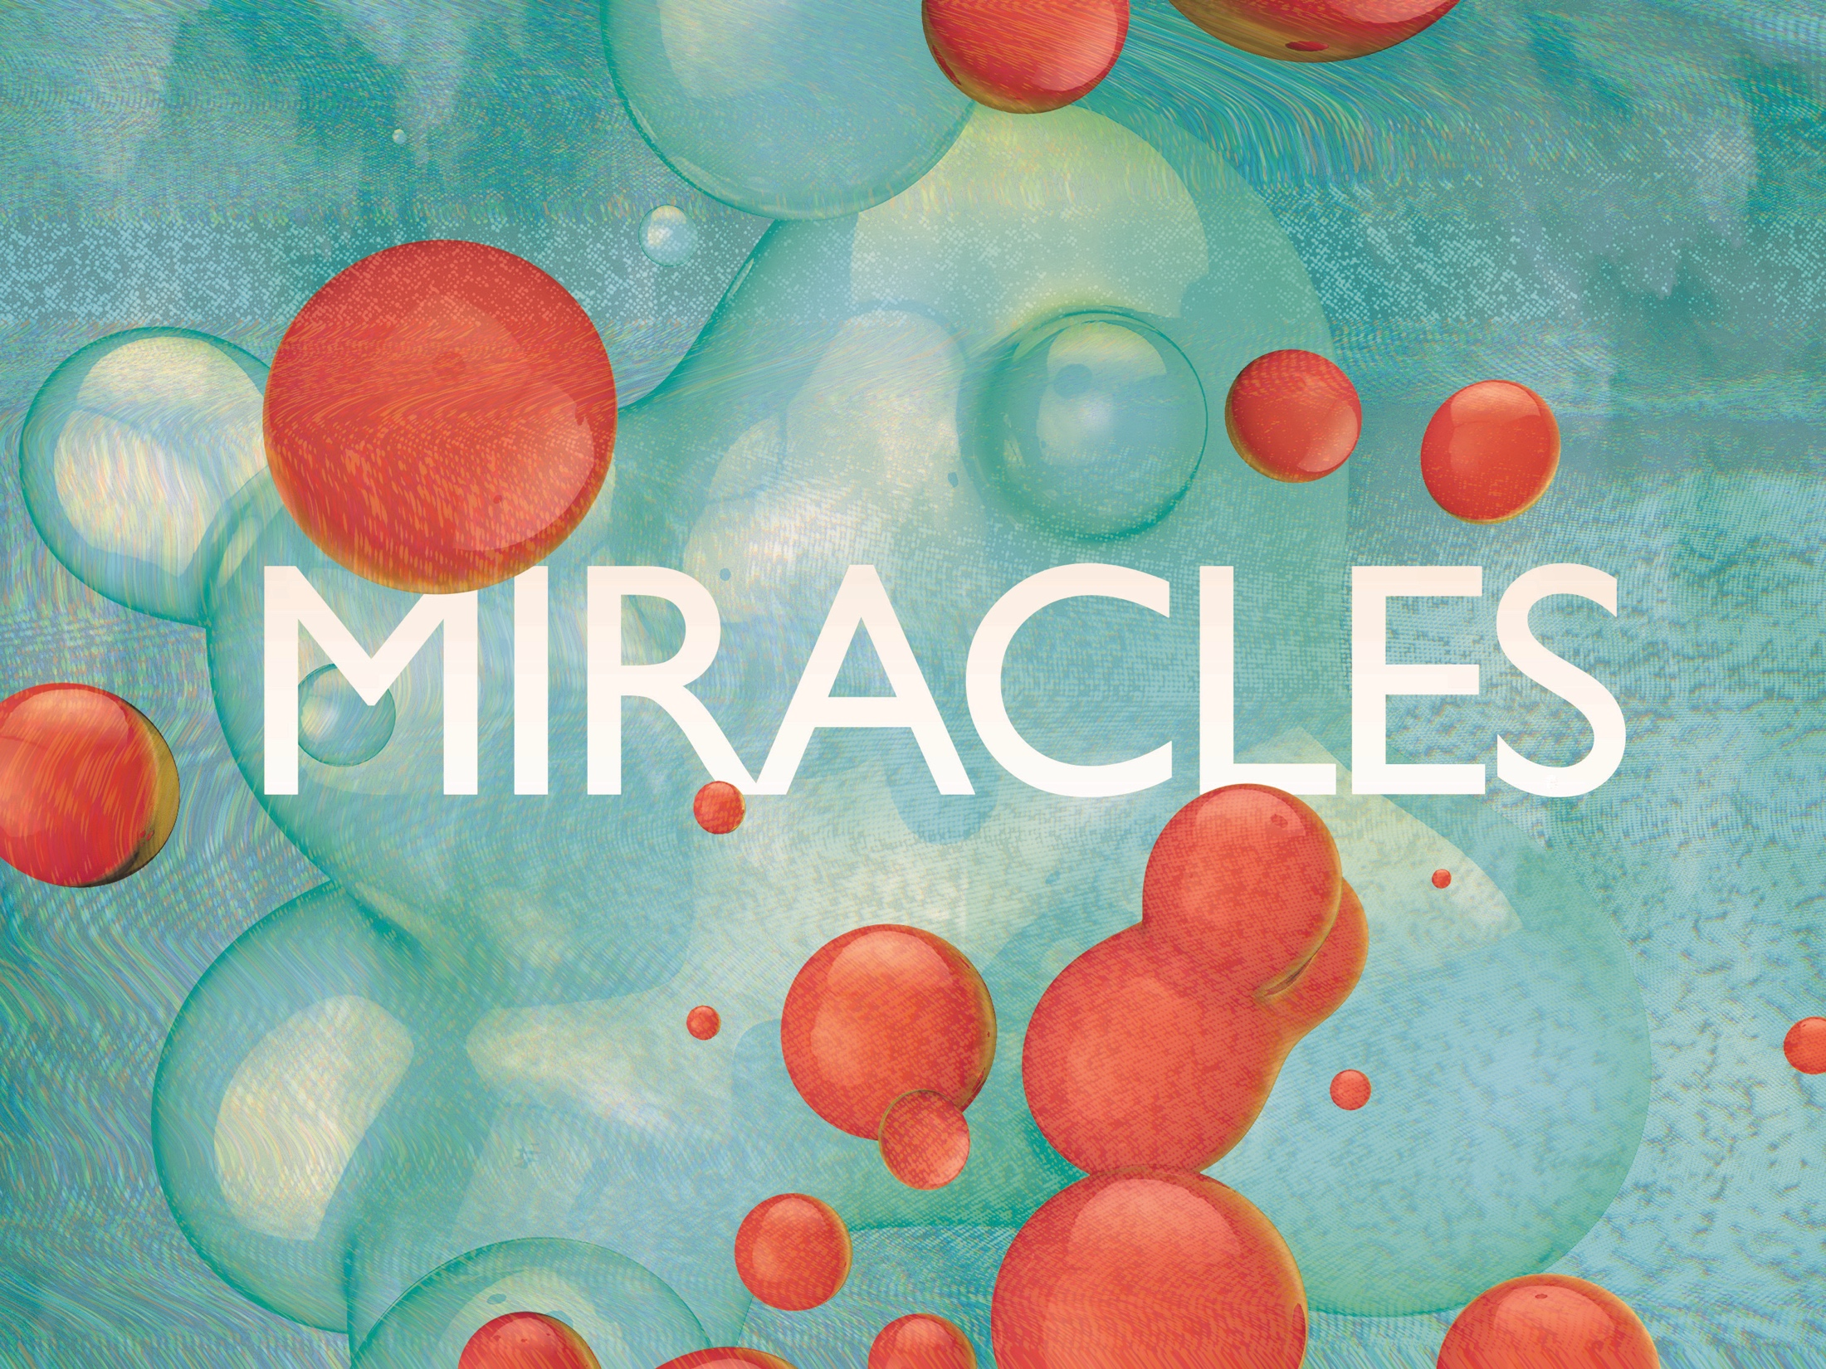
ESV

Slide 2

Your way, O God, is in the sanctuary; who is so great a God as our God? You are the God who does wonders; You have declared Your strength among the peoples.
^{Psalm 77:13-14}
NKJV

Slide 3
Science can explain away miracles.
NKJV

Slide 4
Miracles are evidence of the supernatural that cannot be adequately explained away by science alone.
NKJV

Slide 5
TEMPLATE
•
•
•
NKJV

