Slide 1


Slide 2
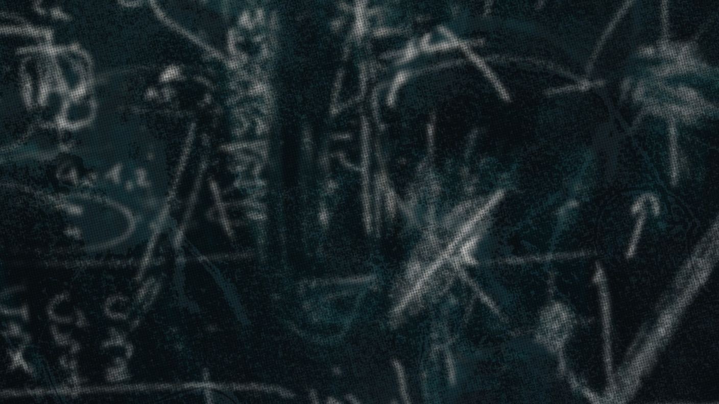
Insert verses here.
^{Proverbs} ^{31:8-9}

Slide 3
I don’t have the power to help others.

Slide 4
Defending means using what you have and who you are to honor the dignity of others.

Slide 5
TEMPLATE
•
•
•

