Slide 1
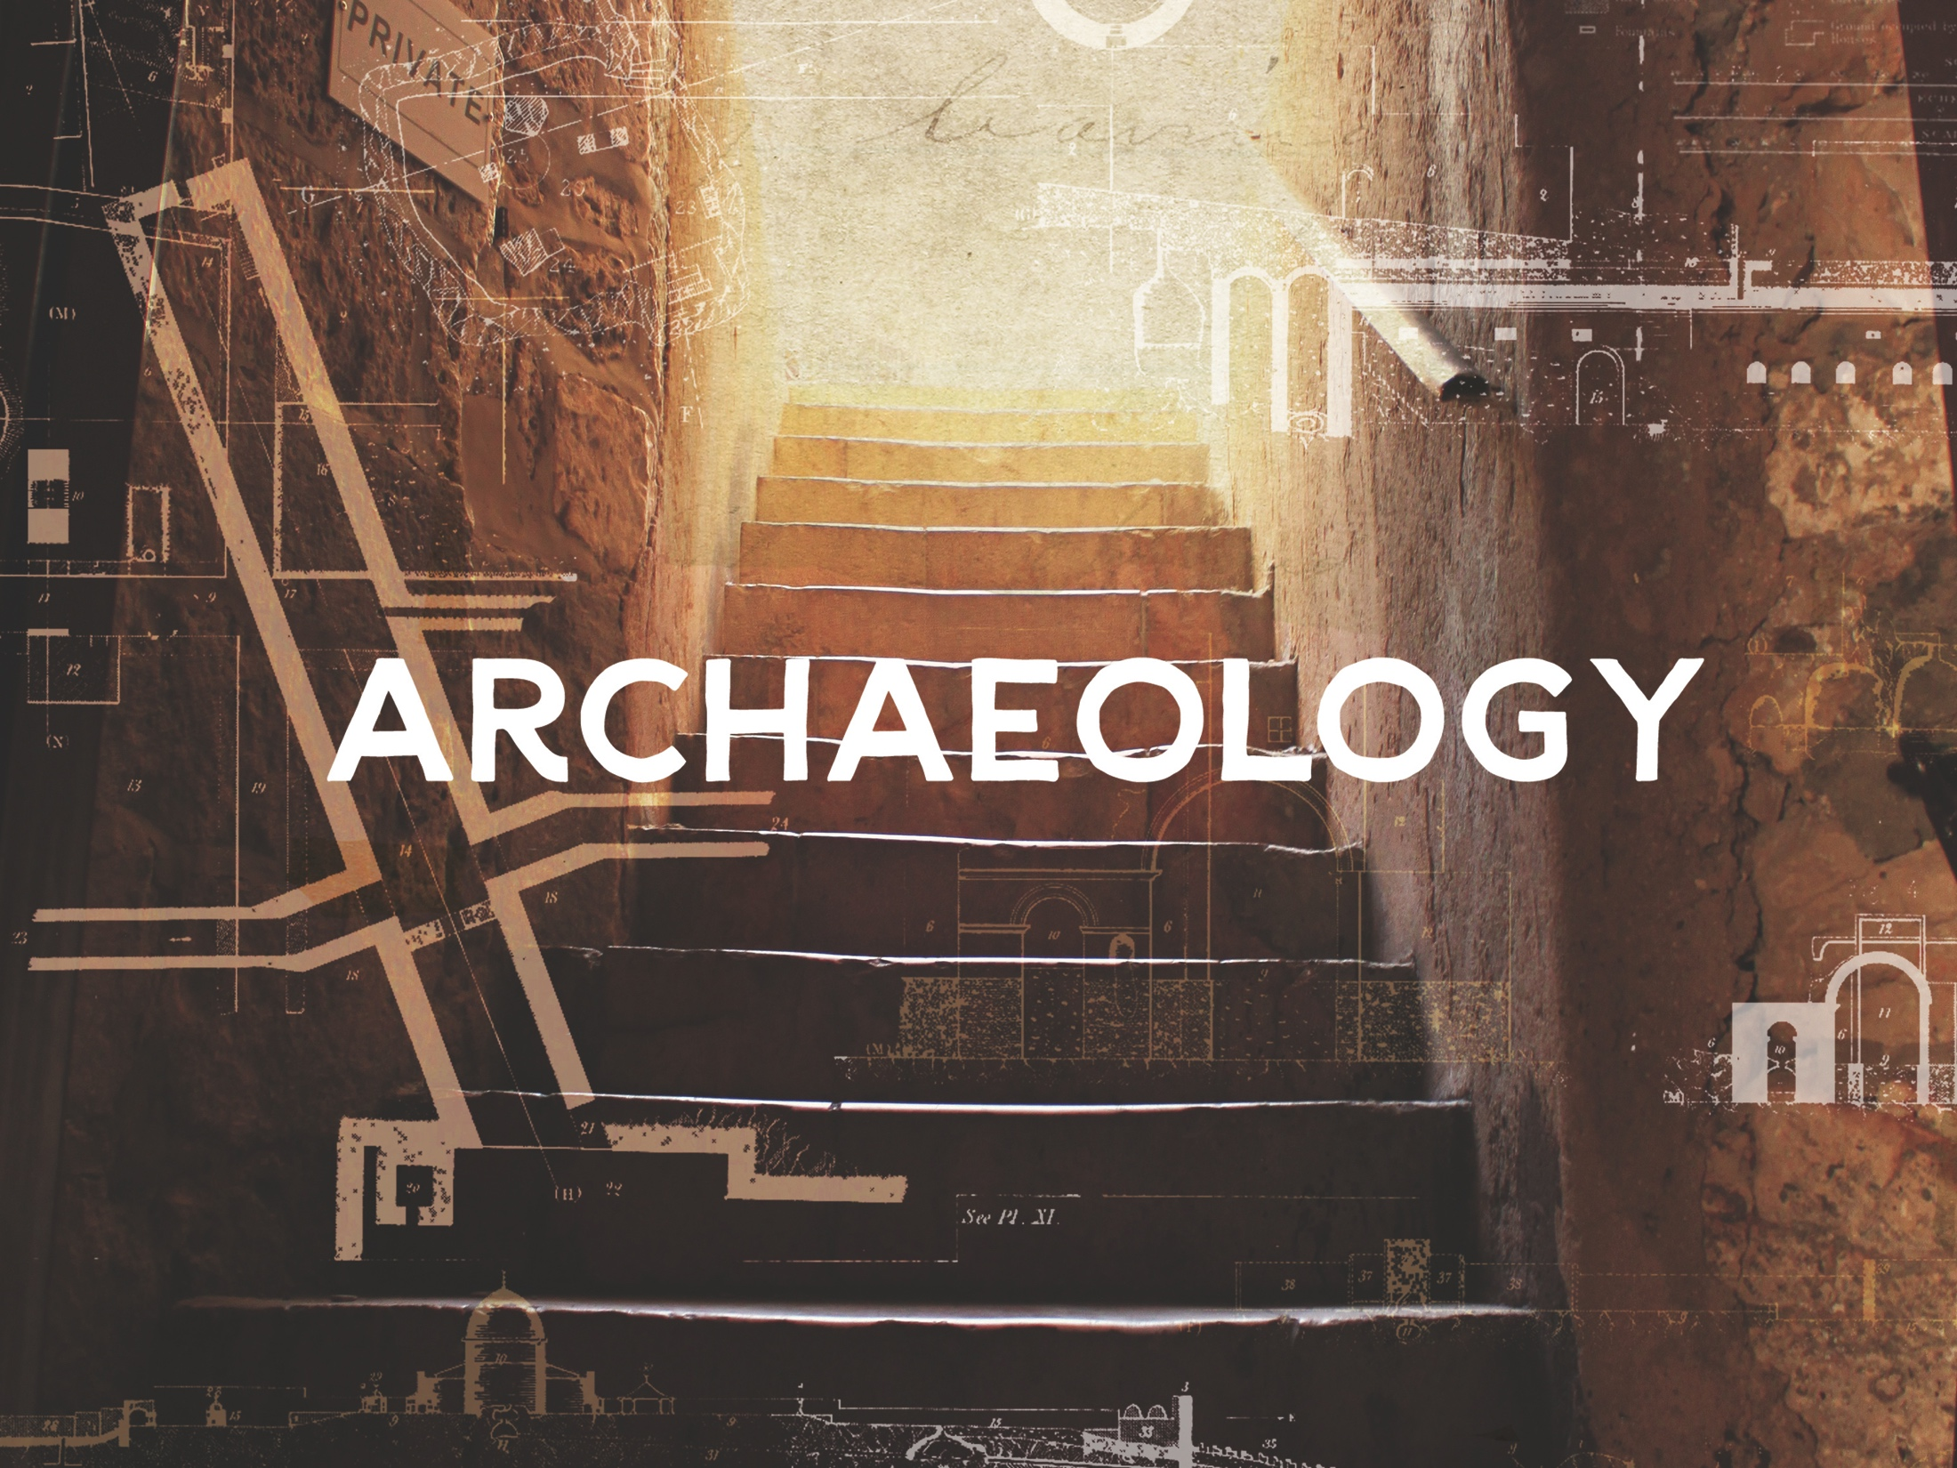
ESV

Slide 2

Now in the fifteenth year of the reign of Tiberius Caesar, Pontius Pilate being governor of Judaea, and Herod being tetrarch of Galilee, and his brother Philip tetrarch of Ituraea and of the region of Trachonitis, and Lysanias the tetrarch of Abilene, Annas and Caiaphas being the high priests, the word of God came unto John the son of Zacharias in the wilderness. And he came into all the country about Jordan, preaching the baptism of repentance for the remission of sins.
^{Luke 3:1-3}
KJV

Slide 3
The archaeological record undermines the reliability of Scripture.
KJV

Slide 4
There are many archaeological finds from both the Old and New Testaments that help strengthen the case for the reliability of Scripture.
KJV

Slide 5
TEMPLATE
•
•
•
KJV

