Slide 1
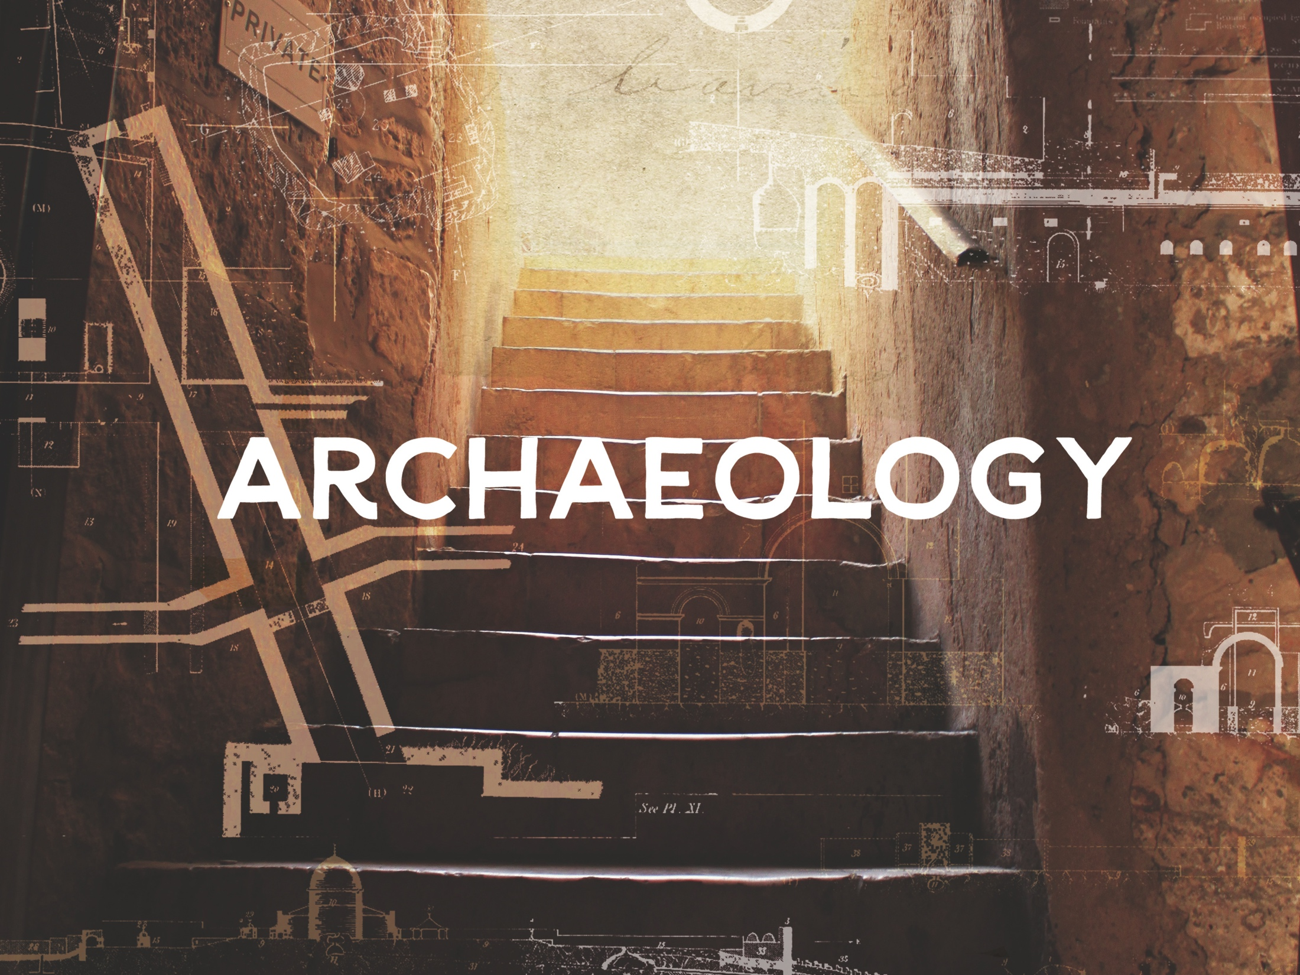
ESV

Slide 2

In the fifteenth year of the reign of Tiberius Caesar — when Pontius Pilate was governor of Judea, Herod tetrarch of Galilee, his brother Philip tetrarch of Iturea and Traconitis, and Lysanias tetrarch of Abilene— during the high priesthood of Annas and Caiaphas, the word of God came to John son of Zechariah in the desert. He went into all the country around the Jordan, preaching a baptism of repentance for the forgiveness of sins.
^{Luke 3:1-3}
NIV

Slide 3
The archaeological record undermines the reliability of Scripture.
NIV

Slide 4
There are many archaeological finds from both the Old and New Testaments that help strengthen the case for the reliability of Scripture.
NIV

Slide 5
TEMPLATE
•
•
•
NIV

