Slide 1
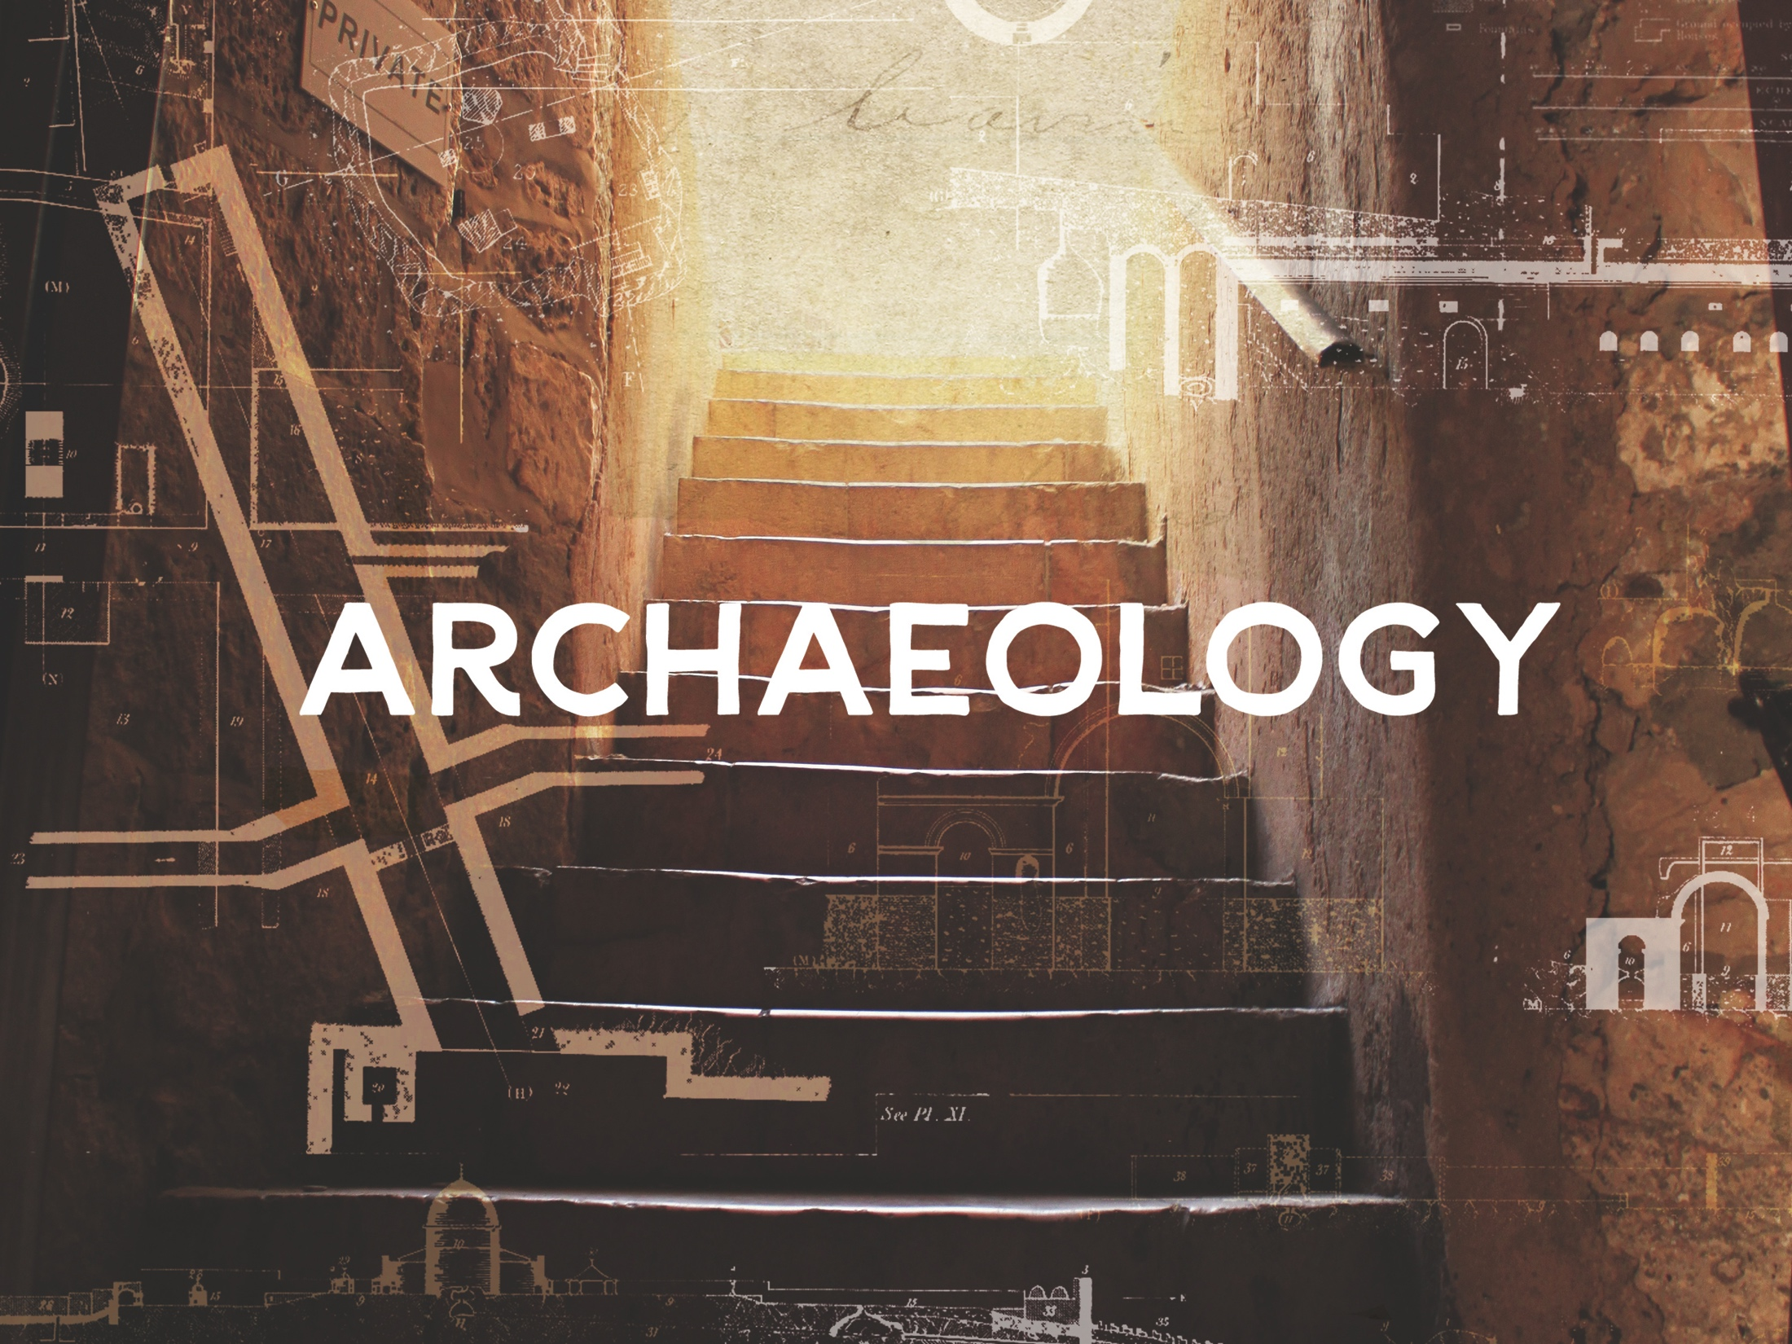
ESV

Slide 2

Now in the fifteenth year of the reign of Tiberius Caesar, Pontius Pilate being governor of Judea, Herod being tetrarch of Galilee, his brother Philip tetrarch of Iturea and the region of Trachonitis, and Lysanias tetrarch of Abilene, while Annas and Caiaphas were high priests, the word of God came to John the son of Zacharias in the wilderness. And he went into all the region around the Jordan, preaching a baptism of repentance for the remission of sins.
^{Luke 3:1-3}
NKJV

Slide 3
The archaeological record undermines the reliability of Scripture.
NKJV

Slide 4
There are many archaeological finds from both the Old and New Testaments that help strengthen the case for the reliability of Scripture.
NKJV

Slide 5
TEMPLATE
•
•
•
NKJV

