Slide 1

ESV

Slide 2
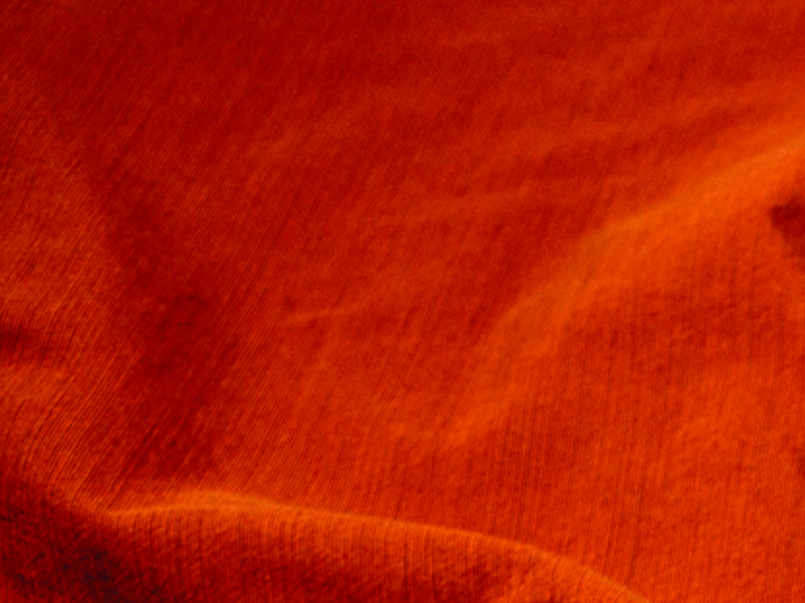
Blessed are you when others revile you and persecute you and utter all kinds of evil against you falsely on My account. Rejoice and be glad, for your reward is great in heaven, for so they persecuted the prophets who were before you.
Matthew 5:11-12
ESV

Slide 3
PERSECUTION DOESN’T HAPPEN ANYMORE.
ESV

Slide 4
IF YOU FOLLOW JESUS, YOU SHOULD EXPECT TO FACE PERSECUTION.
ESV

Slide 5
TEMPLATE
•
•
•
ESV

