Slide 1

KJV

Slide 2
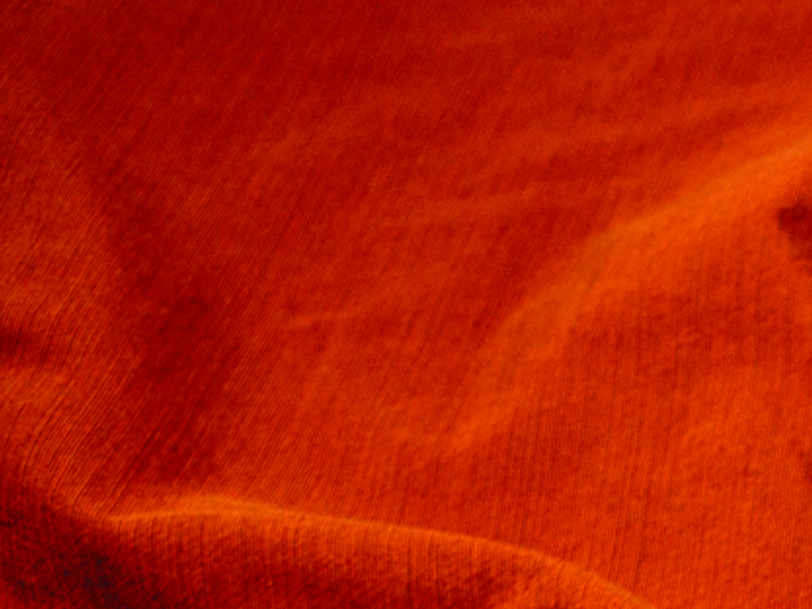
Blessed are ye, when men shall revile you, and persecute you, and shall say all manner of evil against you falsely, for My sake. Rejoice, and be exceeding glad: for great is your reward in heaven: for so persecuted they the prophets which were before you.
Matthew 5:11-12
KJV

Slide 3
PERSECUTION DOESN’T HAPPEN ANYMORE.
KJV

Slide 4
IF YOU FOLLOW JESUS, YOU SHOULD EXPECT TO FACE PERSECUTION.
KJV

Slide 5
TEMPLATE
•
•
•
KJV

