Slide 1

NKJV

Slide 2
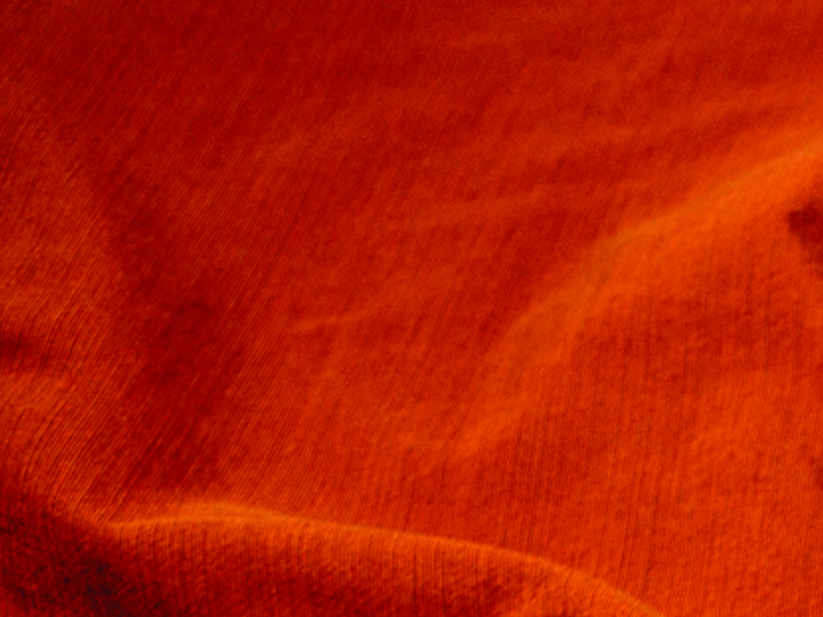
Blessed are you when they revile and persecute you, and say all kinds of evil against you falsely for My sake. Rejoice and be exceedingly glad, for great is your reward in heaven, for so they persecuted the prophets who were before you.
Matthew 5:11-12
NKJV

Slide 3
PERSECUTION DOESN’T HAPPEN ANYMORE.
NKJV

Slide 4
IF YOU FOLLOW JESUS, YOU SHOULD EXPECT TO FACE PERSECUTION.
NKJV

Slide 5
TEMPLATE
•
•
•
NKJV

