Slide 1
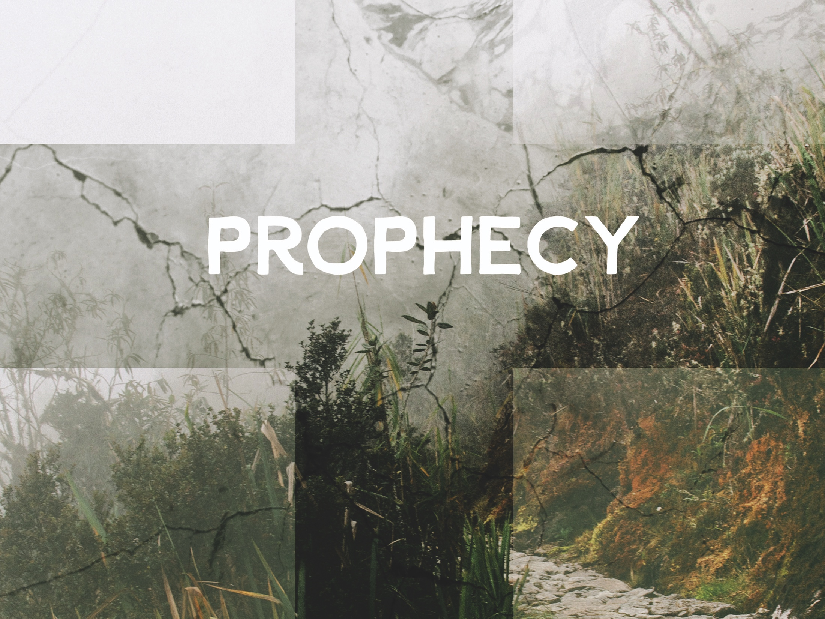
ESV

Slide 2

But He was wounded for our transgressions, He was bruised for our iniquities; the chastisement for our peace was upon Him, and by His stripes we are healed.
^{Isaiah} ^{53:5}
NKJV

Slide 3
The Old Testament prophecies are vague and taken out of context.
NKJV

Slide 4
Biblical prophecy is unique in its accuracy and quantity, which affirms the divine nature of Scripture.
NKJV

Slide 5
TEMPLATE
•
•
•
NKJV

