Slide 1
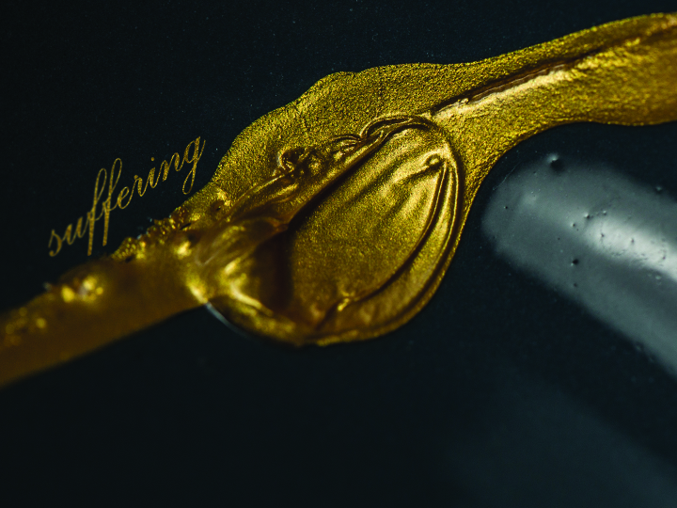
ESV

Slide 2

For I consider that the sufferings of this present time are not worth comparing with the glory that is to be revealed to us.
Romans 8:18
ESV

Slide 3
THE CHRISTIAN LIFE IS EASY.
ESV

Slide 4
SUFFERING IS TEMPORARY. GLORY IS ETERNAL.
ESV

Slide 5
TEMPLATE
•
•
•
ESV

