Slide 1
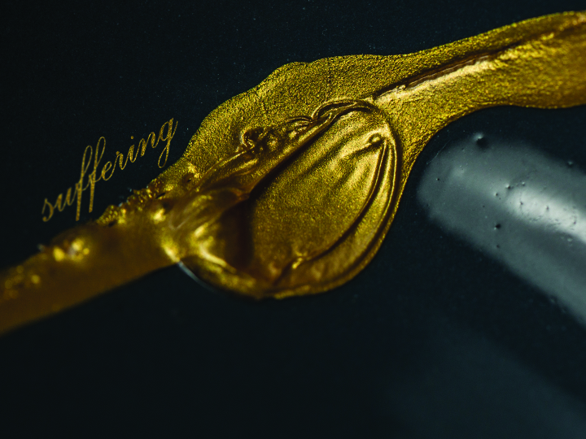
KJV

Slide 2

For I reckon that the sufferings of this present time are not worthy to be compared with the glory which shall be revealed in us.
Romans 8:18
KJV

Slide 3
THE CHRISTIAN LIFE IS EASY.
KJV

Slide 4
SUFFERING IS TEMPORARY. GLORY IS ETERNAL.
KJV

Slide 5
TEMPLATE
•
•
•
KJV

