Slide 1
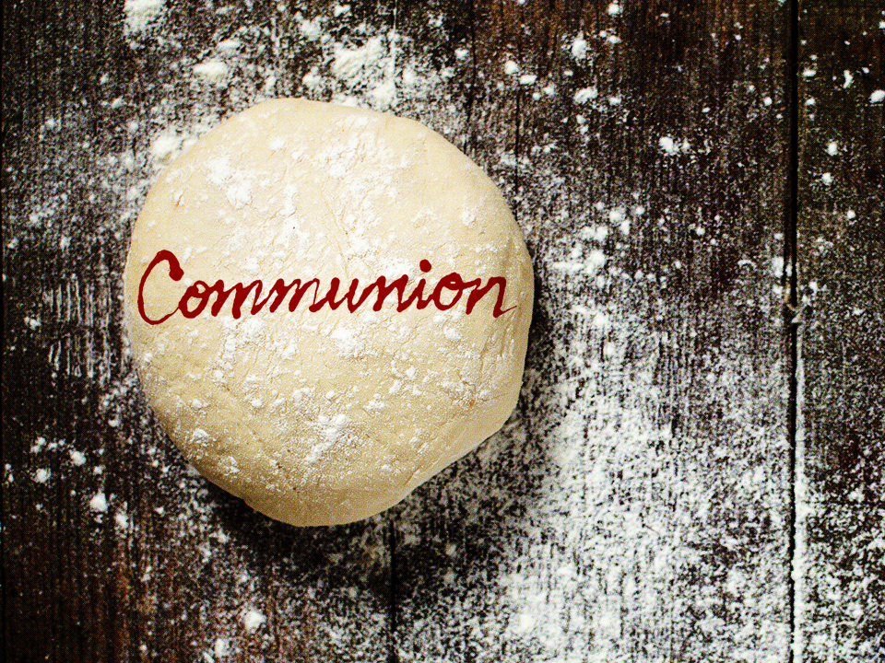
KJV

Slide 2
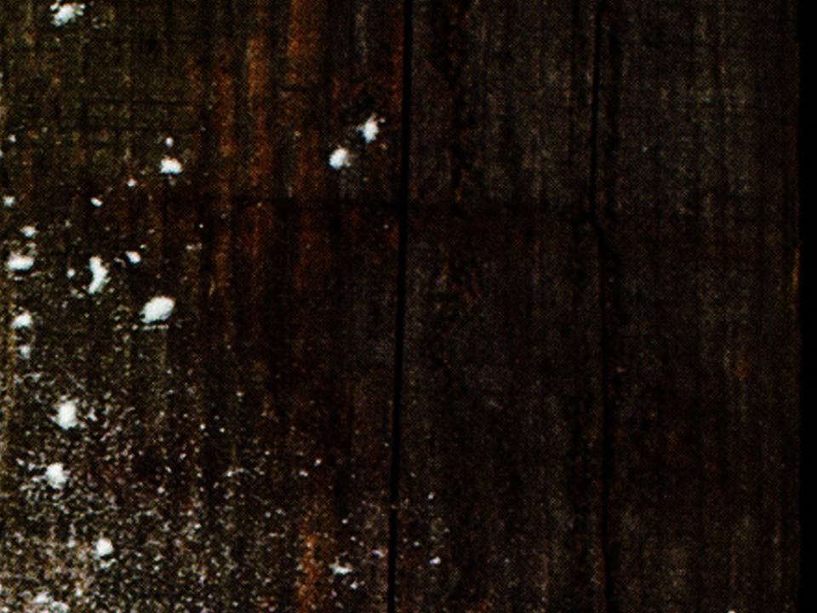
And when He had given thanks, He brake it, and said, “Take, eat: this is My body, which is broken for you: this do in remembrance of Me.” After the same manner also He took the cup, when He had supped, saying, “This cup is the new testament in My blood: this do ye, as oft as ye drink it, in
remembrance of Me.”
1 Corinthians 11:24-25
KJV

Slide 3
I CAN’T PARTICIPATE IN COMMUNION BECAUSE I’M NOT GOOD ENOUGH.
KJV

Slide 4
WE ARE MADE WORTHY BY JESUS’ SACRIFICIAL DEATH ON THE CROSS.
KJV

Slide 5
TEMPLATE
•
•
•
KJV

