Slide 1
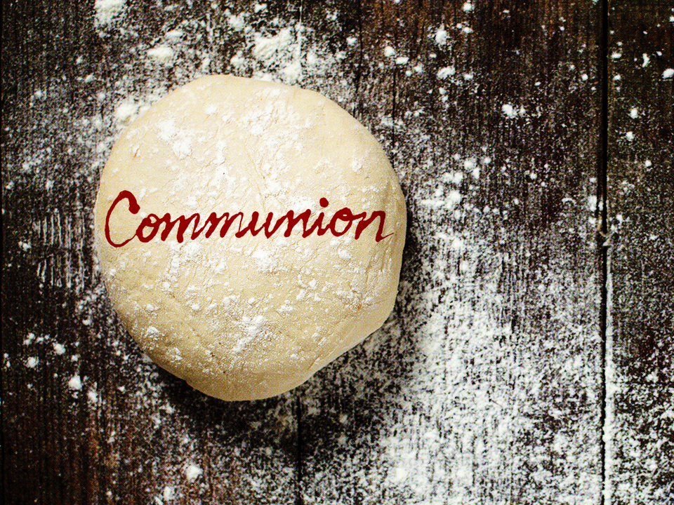
NKJV

Slide 2
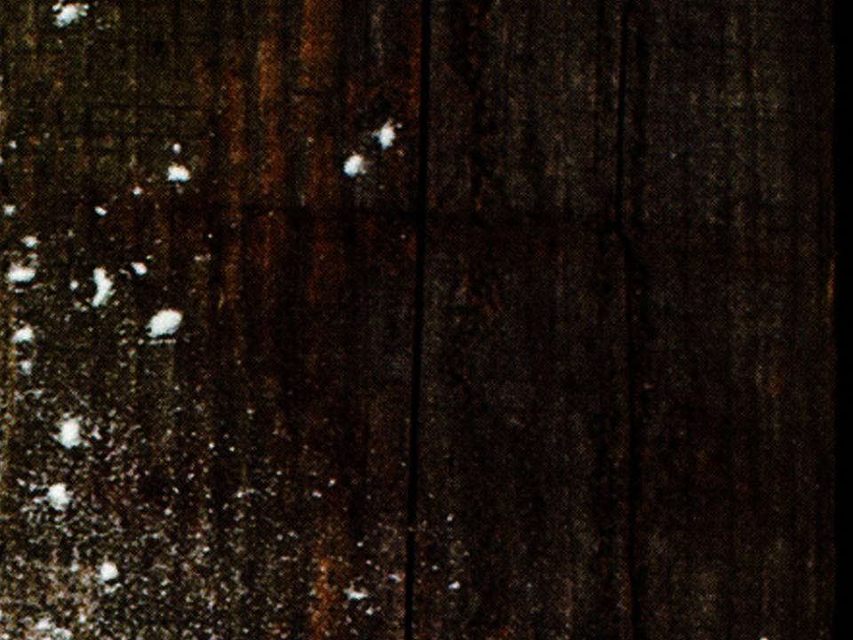
And when He had given thanks, He broke it and said, “Take, eat; this is My body which is broken for you; do this in remembrance of Me.” In the same manner He also took the cup after supper, saying, “This cup is the new covenant in My blood. This do, as often as you drink it, in
remembrance of Me.”
1 Corinthians 11:24-25
NKJV

Slide 3
I CAN’T PARTICIPATE IN COMMUNION BECAUSE I’M NOT GOOD ENOUGH.
NKJV

Slide 4
WE ARE MADE WORTHY BY JESUS’ SACRIFICIAL DEATH ON THE CROSS.
NKJV

Slide 5
TEMPLATE
•
•
•
NKJV

