Slide 1

NIV

Slide 2
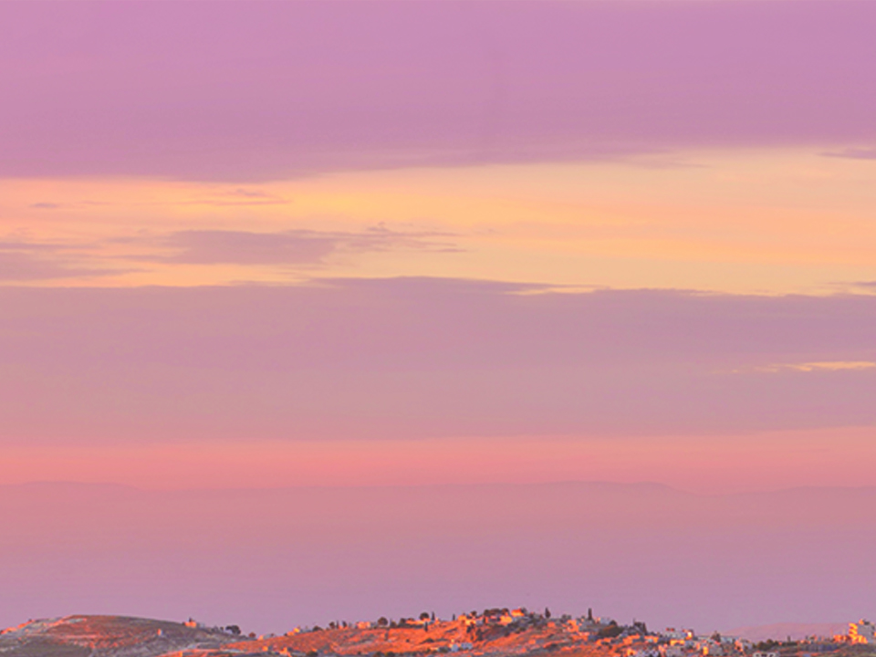
Then Peter began to speak: “I now realize how true it is that God does not show favoritism but accepts men from every nation who fear Him and do what is right.”
Acts 10:34-35
NIV

Slide 3
I CAN’T RELATE TO PEOPLE OUTSIDE OF MY REGULAR CIRCLE.
NIV

Slide 4
THE GOSPEL IS FOR ALL PEOPLE EVERYWHERE.
NIV

Slide 5
TEMPLATE
•
•
•
NIV

