Slide 1

NKJV

Slide 2
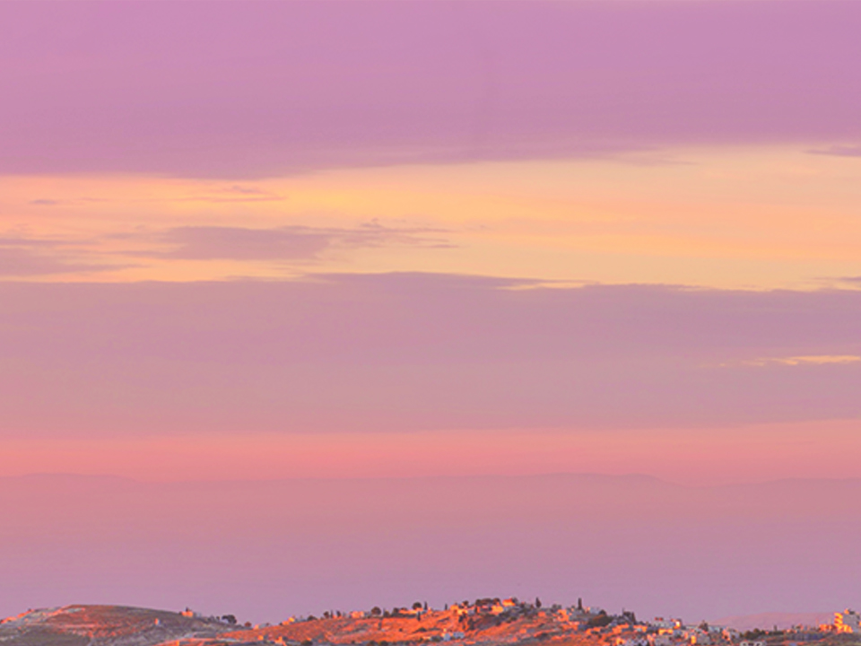
Then Peter opened his mouth and said:
“In truth I perceive that God shows no partiality. But in every nation whoever fears Him and works righteousness is
accepted by Him.
Acts 10:34-35
NKJV

Slide 3
I CAN’T RELATE TO PEOPLE OUTSIDE OF MY REGULAR CIRCLE.
NKJV

Slide 4
THE GOSPEL IS FOR ALL PEOPLE EVERYWHERE.
NKJV

Slide 5
TEMPLATE
•
•
•
NKJV

