Slide 1
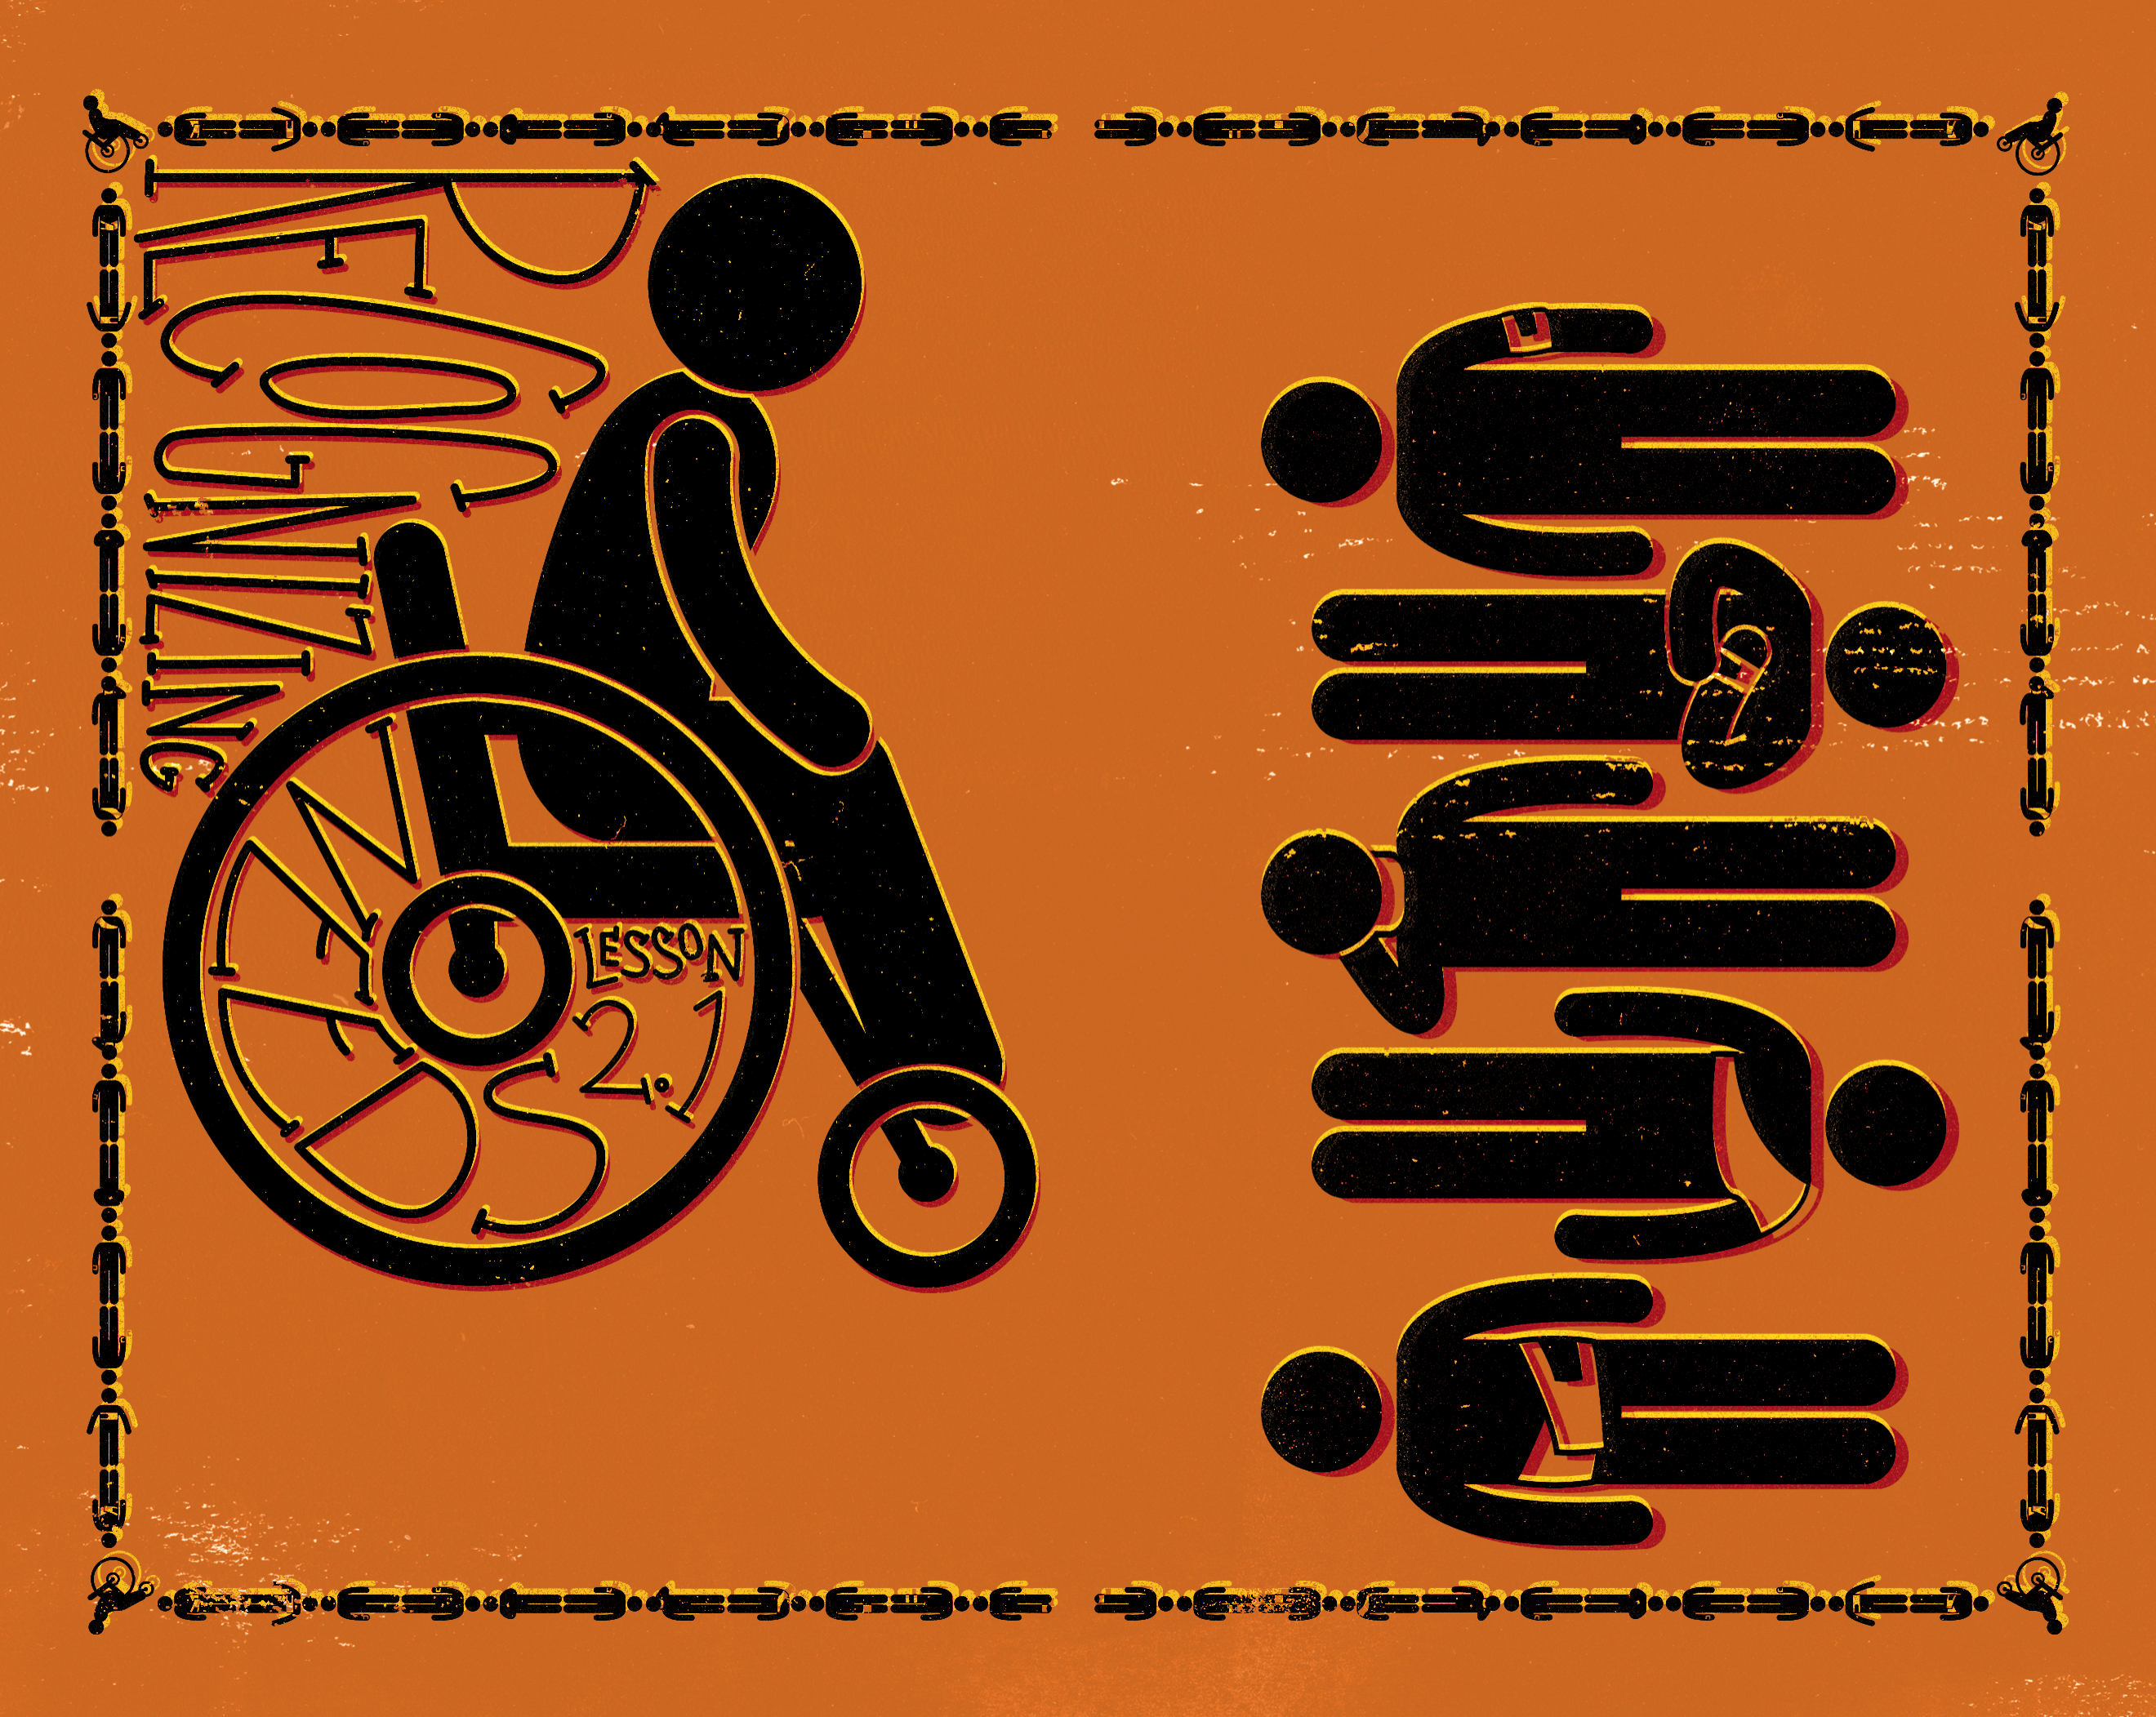

Slide 2

Now when the sun was setting, all those who had any who were sick with various diseases brought them to Him, and He laid His hands on every one of them and healed them.
^{Luke 4:40}

Slide 3
Jesus recognized needs.
Jesus responded to needs.
Jesus served and met a variety of needs.

Slide 4
Enter Content Here.
Enter content here.
Enter content here
Enter content here

